Slide 1
eXponential
TESTS
LEARN
BUILD
Product
REFACTOR
DATA
CODE
MEASURE
Management
Copyright © Peter Merel 2017 for Fast Pants Mobile Apps Pty. Ltd.
Notes:
What happened with “statement”?

Slide 2
Course Outline
Why, Who, How & What?
The XSCALE Principles
Game: Two Minty Machines
Throughput Accounting
Practice: Pirate Canvas
Agile Contracts
Game: Three More Minty Machines
Forming a Product Squad
Practice: Behavior Driven Analysis
Using a Kanban to whip WIP
Practice: Behavior Driven Development
Continuous Deployment
Game: Set-based Logo Design
Set-based UX Design
Product Squad Ceremonies
LaaS & DRIs
Practice: Business Bingo
Change as a Product
Practice: Release Refactoring
Ecosystems Thinking

Slide 3
Why are you taking this course? (the business problem that motivated you)
Whose behaviour would have to change to solve that? (if not yours, why are you the student here?)
How does it show up for them as a problem? (how to motivate a change in their behaviour?)
What do you have to do to achieve that? (what would have the greatest impact on their behavior?)

Slide 4
What’s the difference between Agile Organization and some other kind?
eXponential return
Simple design
Continuous throughput
Autonomous teams
Learning: triple-loop
Ecosystems thinking
www.xscalealliance.org

Slide 5
eXponential return
Products are service ecosystems
Product return curves are sigmoids
Don’t chain the curves; stack them

Slide 6
eXponential
Everybody wants
to be Uber …

Slide 7

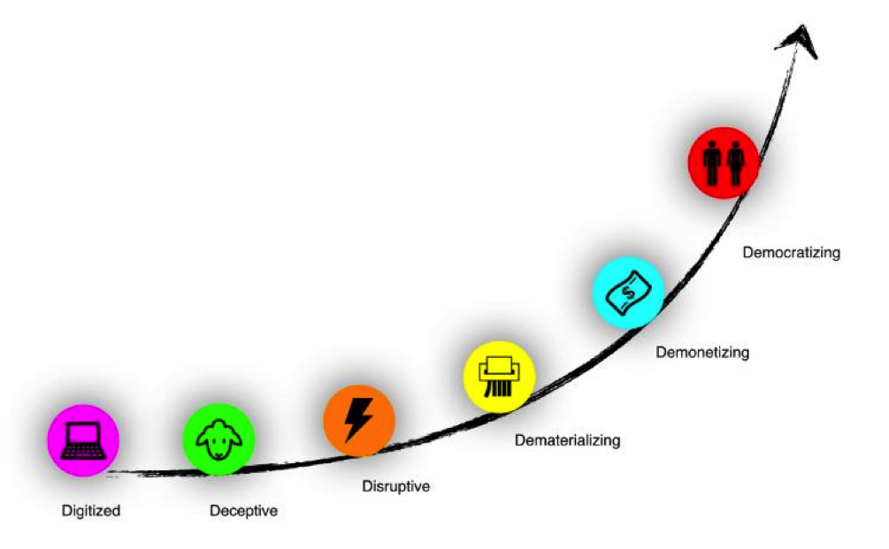
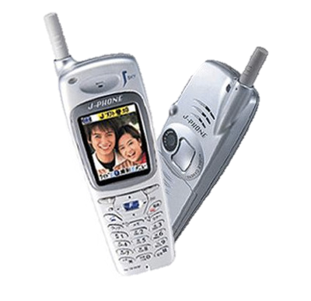

eXponential
Democratization
Demonetization
Dematerialization
Disruption
Digitalization
Deception
Notes:
What happened with “statement”?

Slide 8
eXponential
Democratization
Demonetization
Dematerialization
Disruption
Digitalization
Deception
Notes:
What happened with “statement”?

Slide 9






eXponential
Notes:
What happened with “statement”?

Slide 10
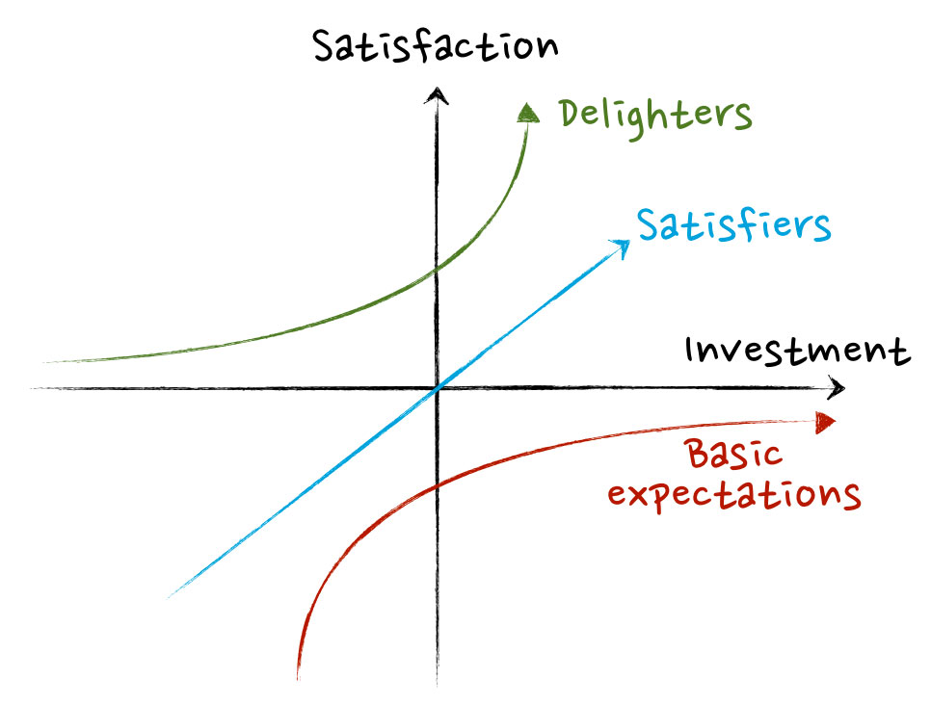
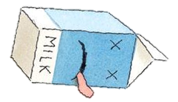
eXponential
But Kano.
Notes:
What happened with “statement”?

Slide 11
eXponential
But Kano.
Notes:
What happened with “statement”?

Slide 12
eXponential
Entropy
Notes:
What happened with “statement”?

Slide 13
eXponential
Linear growth
Notes:
What happened with “statement”?

Slide 14
eXponential
Extropy
Notes:
What happened with “statement”?

Slide 15
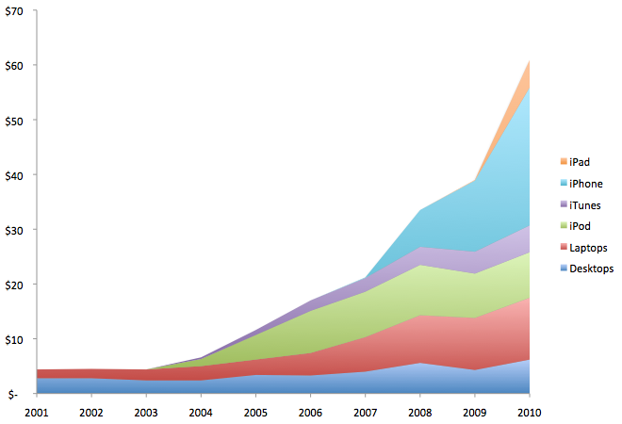
eXponential
”If anyone is going to obsolete us, I want it to be us.” – Steve Jobs
Extropy begins with an Agile mindset.
Notes:
What happened with “statement”?

Slide 16
An Exponential Game

Slide 17
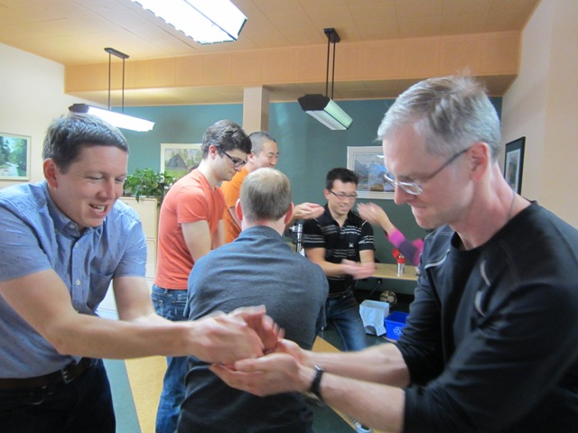
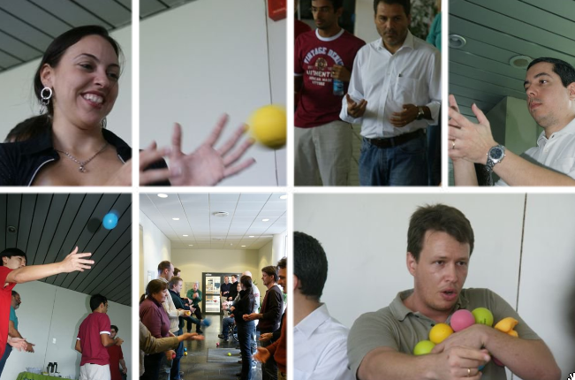
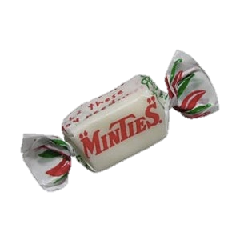
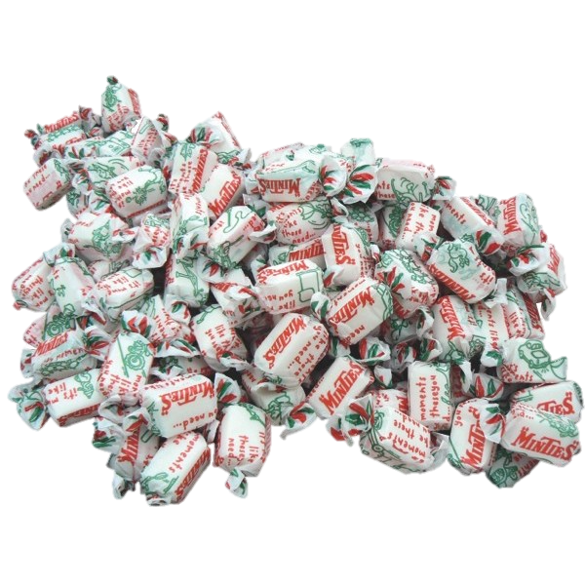
Ceremonies
Two Minute Sprints.
One minute Retro.
Estimate Throughput.
Solution Constraints
Air-time! No containers!
Minties stop where they start!
Don’t pass left<->right!

Slide 18
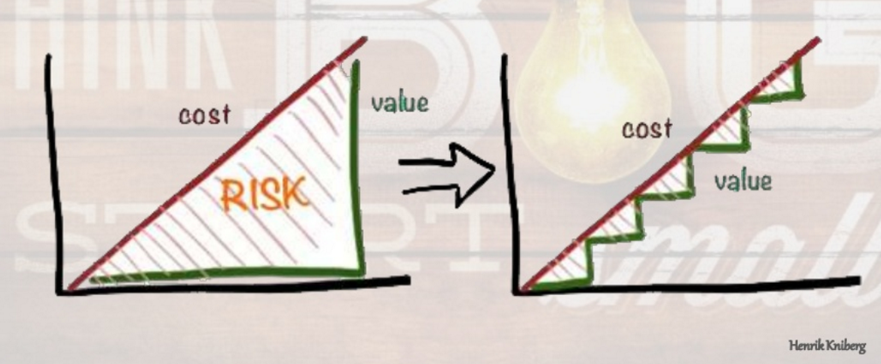

Waterfall
Agile
Performing
Norming
Storming
Forming
How do we open this bottleneck?
Notes:
What happened with “statement”?

Slide 19
Simple design
Design means the elegance of minimum
Not look and feel; how the ecosystem works
Design, Delivery & Devops –> hand-in-glove

Slide 20
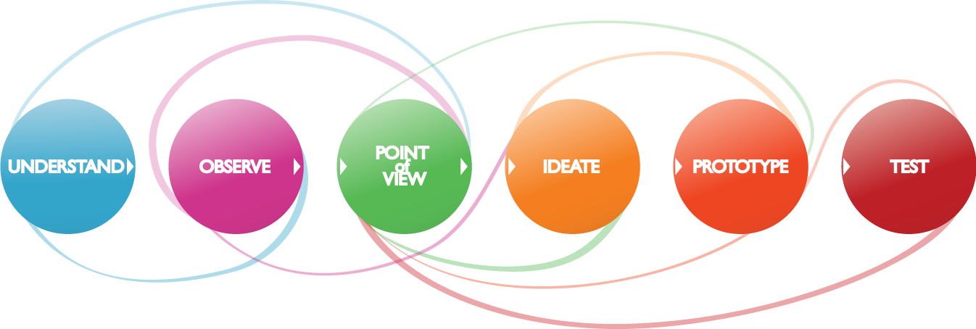
Simple
Design Thinking

Slide 21
Simple
Design Thinking

Slide 22
Simple
Design Thinking

Slide 23
Simple
Design Thinking

Slide 24
Simple
Design Thinking

Slide 25
Simple
Design Thinking

Slide 26
Simple
Design Thinking

Slide 27
Simple
Design Thinking isn’t about simple

Slide 28
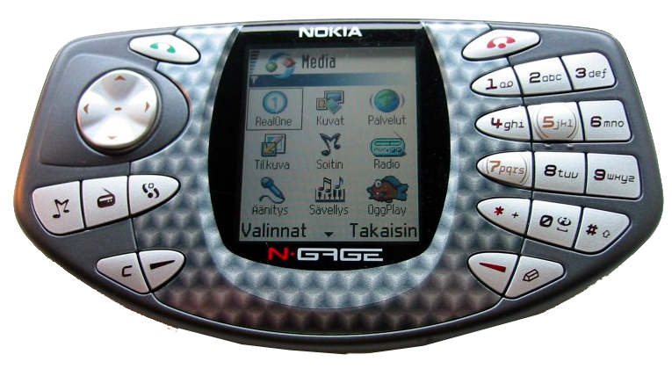
Simple
2003 Nokia N-Gage. “The Taco Phone”. Apps. Internet.
MP3s. Everything iPhone did …
4 years before iPhone.

Slide 29
Simple
2004 Nokia N-Gage QD. Design Thinking by IDEO.
Improved look and feel.
Sank like a stone.

Slide 30
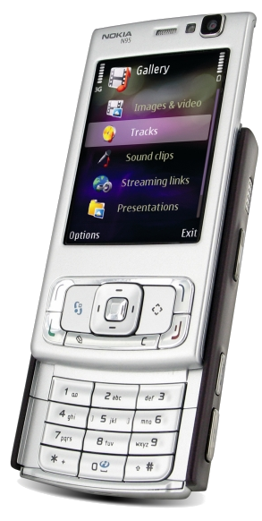
Simple
2008 Nokia N-Gage Next Gen. Design Thinking by IDEO.
An app store for Nokia phones.
Discontinued 2009.

Slide 31

Simple
iPhone 2007 threw Design Thinking out the window.
“People don't know what they want till you show them.”.

Slide 32
Simple
“Design means the elegance of minimum.
It isn’t look and feel. It’s how it works.” -- Jobs
Notes:
What happened with “statement”?

Slide 33
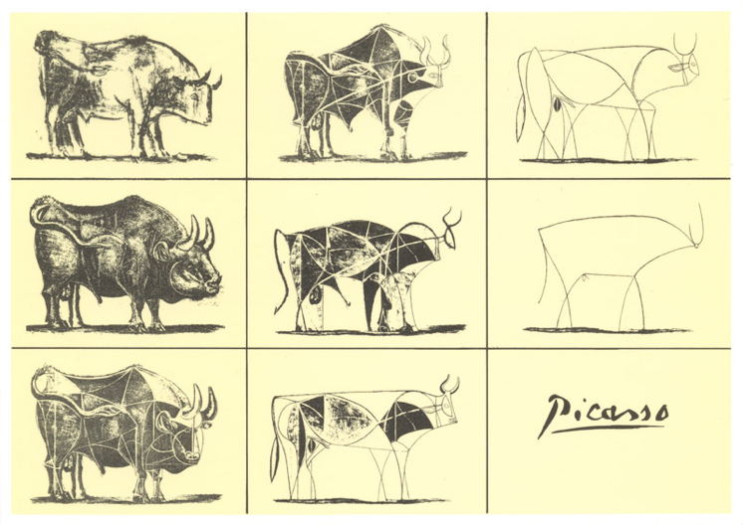
Simple
“Design means the elegance of minimum.
It isn’t look and feel. It’s how it works.” -- Jobs
Notes:
What happened with “statement”?

Slide 34
Simple
“Design means the elegance of minimum.
It isn’t look and feel. It’s how it works.” -- Jobs
Notes:
What happened with “statement”?

Slide 35
Simple
“Design means the elegance of minimum.
It isn’t look and feel. It’s how it works.” -- Jobs
Notes:
What happened with “statement”?

Slide 36
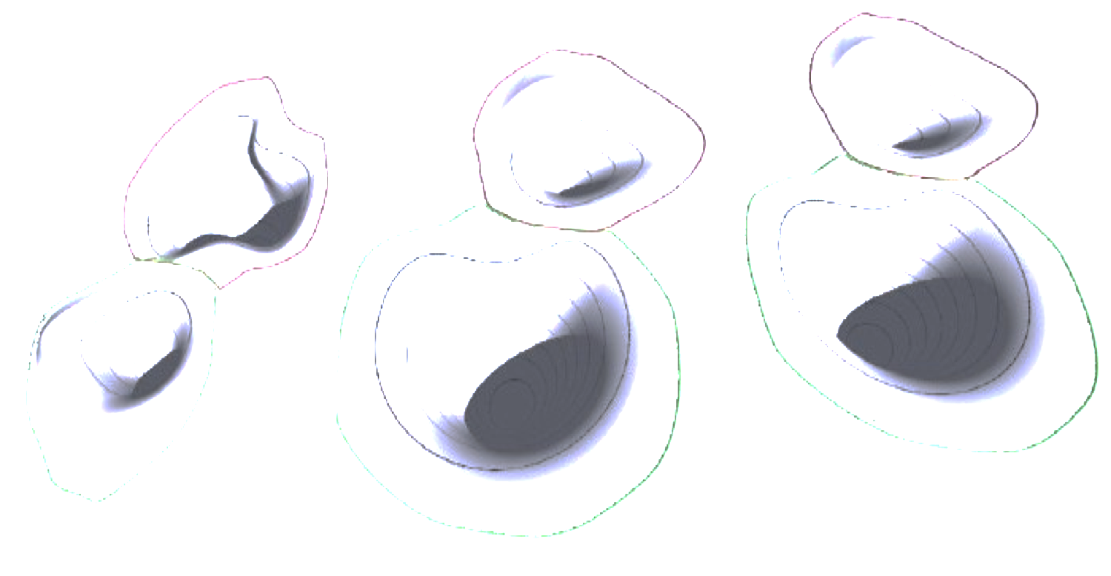
Simple
“Design means the elegance of minimum.
It isn’t look and feel. It’s how it works.” -- Jobs
Notes:
What happened with “statement”?

Slide 37
Simple

Slide 38
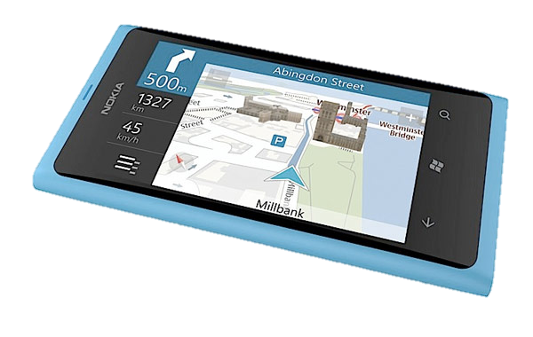

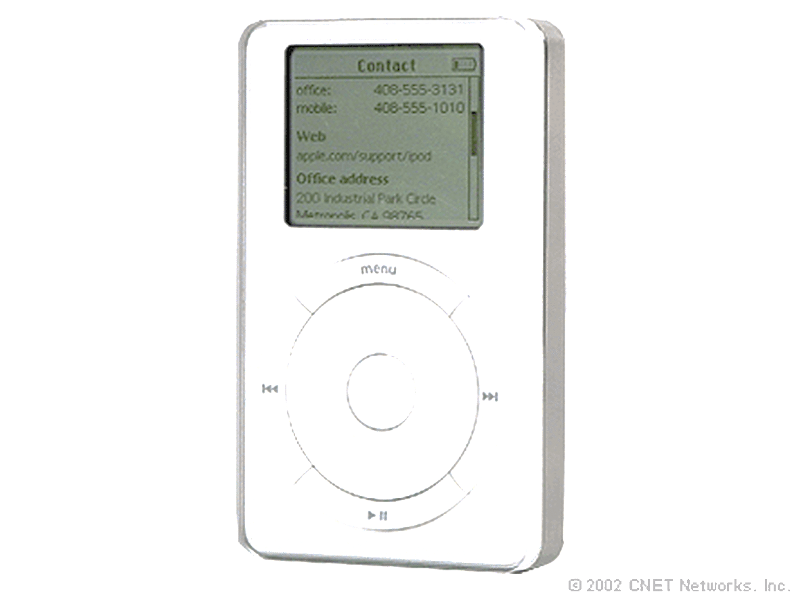
Simple
Nokia “Dumb”
Phone
Nokia
“Smart” Phone
Windows
Phablet
iPod
iPhone
iPad
Design Space
Notes:
The relationship between process, team structure, and value stream function.
Processes
Impact Mapping
Acceptability Matrix
Backlog Bingo
Release Refactoring
Story Mapping
Scrumban
BDD
CD
Structure
Strategic Execution
Strategy Mapping

Slide 39
Simple
Nokia “Dumb”
Phone
Nokia
“Smart” Phone
Windows
Phablet
iPod
iPhone
iPad
Design Space
Notes:
The relationship between process, team structure, and value stream function.
Processes
Impact Mapping
Acceptability Matrix
Backlog Bingo
Release Refactoring
Story Mapping
Scrumban
BDD
CD
Structure
Strategic Execution
Strategy Mapping

Slide 40
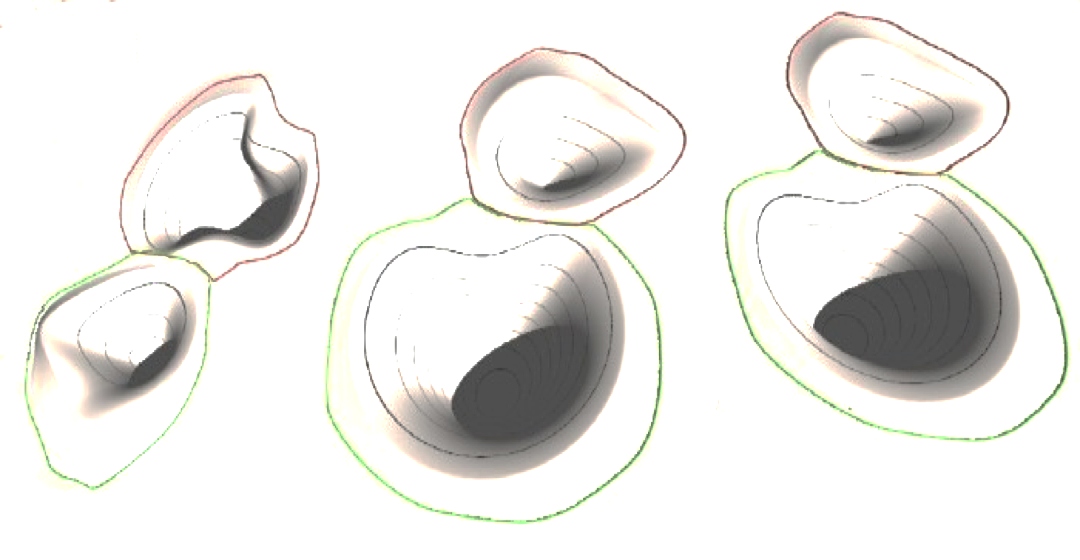
Simple
Nokia “Dumb”
Phone
Symbian
Phone
Windows
Phablet
iPod
iPhone
iPad
Design Space isn’t flat. It’s curved and dynamic.
Like spacetime.
Notes:
The relationship between process, team structure, and value stream function.
Processes
Impact Mapping
Acceptability Matrix
Backlog Bingo
Release Refactoring
Story Mapping
Scrumban
BDD
CD
Structure
Strategic Execution
Strategy Mapping

Slide 41
Simple
Kano explains why.
Notes:
What happened with “statement”?

Slide 42
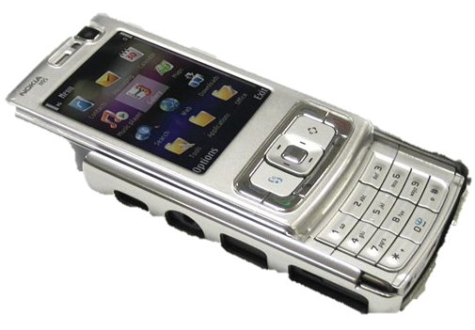
Simple
Nokia “Dumb”
Phone
Symbian
Phone
Windows
Phablet
iPod
iPhone
iPad
Products aren’t devices. Devices only represent products.
Products are “how it works”. They’re service ecosystems.
Notes:
The relationship between process, team structure, and value stream function.
Processes
Impact Mapping
Acceptability Matrix
Backlog Bingo
Release Refactoring
Story Mapping
Scrumban
BDD
CD
Structure
Strategic Execution
Strategy Mapping

Slide 43

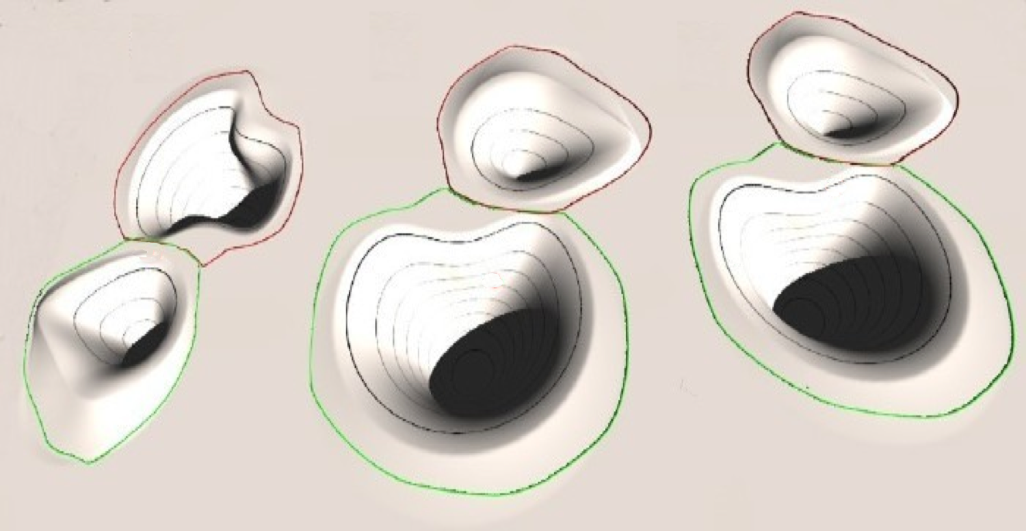
Simple
Customer
Nokia “Dumb”
Phone
Symbian
Phone
Windows
Phablet
iPod
iPhone
iPad
Products aren’t devices. Devices only represent products.
Products are “how it works”. They’re service ecosystems.
Notes:
The relationship between process, team structure, and value stream function.
Processes
Impact Mapping
Acceptability Matrix
Backlog Bingo
Release Refactoring
Story Mapping
Scrumban
BDD
CD
Structure
Strategic Execution
Strategy Mapping

Slide 44
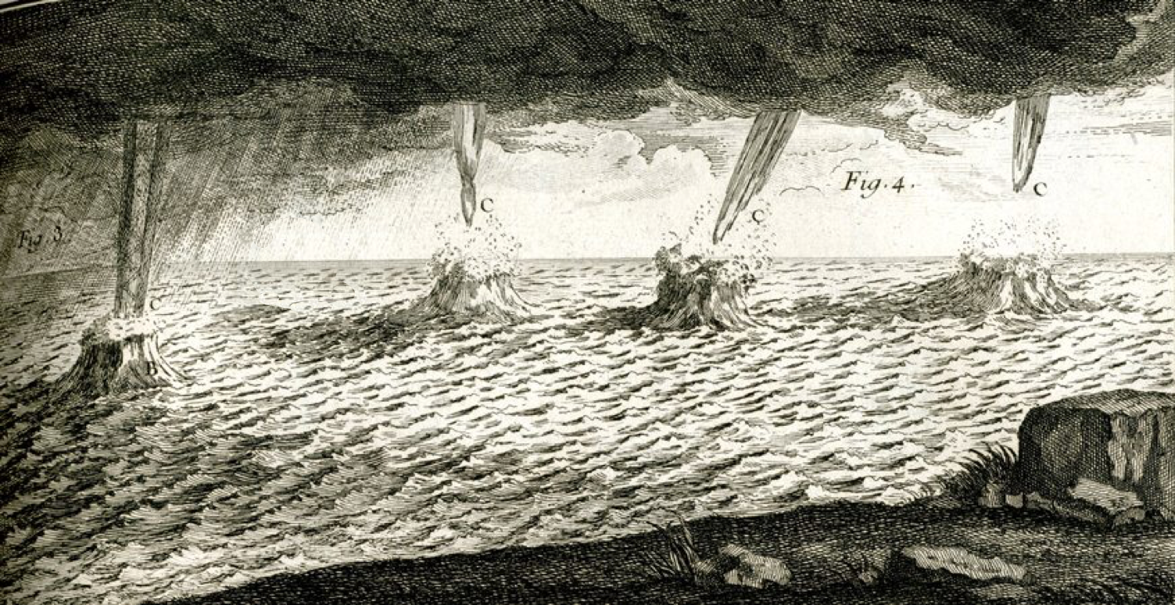
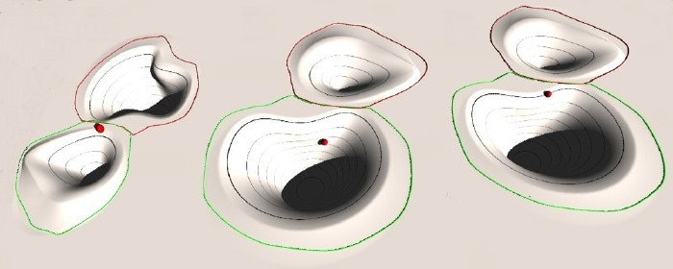
Simple
Customer
Unhappy
Paths
Service ecosystems are defined by their “Pirate Metrics”.
Acquisition.
Activation.
Retention.
Revenue.
Referral.
Notes:
The relationship between process, team structure, and value stream function.
Processes
Impact Mapping
Acceptability Matrix
Backlog Bingo
Release Refactoring
Story Mapping
Scrumban
BDD
CD
Structure
Strategic Execution
Strategy Mapping

Slide 45
Simple
Customer
Designing iPhone …
Notes:
The relationship between process, team structure, and value stream function.
Processes
Impact Mapping
Acceptability Matrix
Backlog Bingo
Release Refactoring
Story Mapping
Scrumban
BDD
CD
Structure
Strategic Execution
Strategy Mapping

Slide 46
Simple
Customer
Acquisition: take the product out of the big box stores.
->
Notes:
The relationship between process, team structure, and value stream function.
Processes
Impact Mapping
Acceptability Matrix
Backlog Bingo
Release Refactoring
Story Mapping
Scrumban
BDD
CD
Structure
Strategic Execution
Strategy Mapping

Slide 47
Simple
Customer
Retention: multi-touch UX obsoletes all hard-button phones.
->
->
Notes:
The relationship between process, team structure, and value stream function.
Processes
Impact Mapping
Acceptability Matrix
Backlog Bingo
Release Refactoring
Story Mapping
Scrumban
BDD
CD
Structure
Strategic Execution
Strategy Mapping

Slide 48
Simple
Customer
Activation: migrate iTunes accounts and media to iPhone
->
->
->
Notes:
The relationship between process, team structure, and value stream function.
Processes
Impact Mapping
Acceptability Matrix
Backlog Bingo
Release Refactoring
Story Mapping
Scrumban
BDD
CD
Structure
Strategic Execution
Strategy Mapping

Slide 49
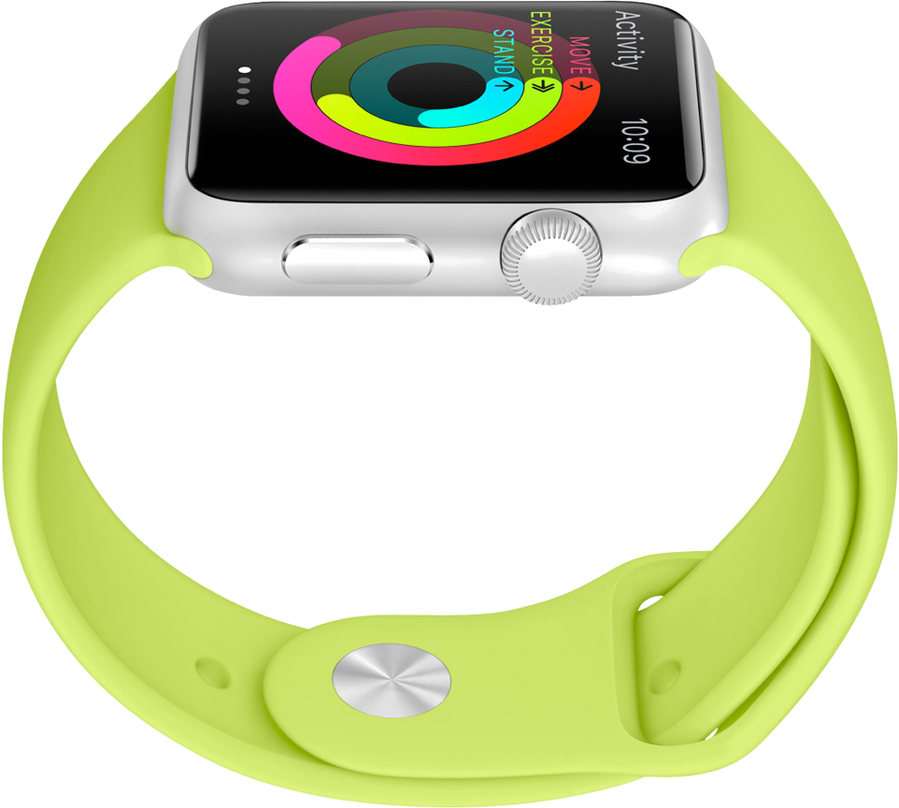
Simple
Customer
Revenue: App Store obsoletes the software retailing industry.
->
->
->
->
Notes:
The relationship between process, team structure, and value stream function.
Processes
Impact Mapping
Acceptability Matrix
Backlog Bingo
Release Refactoring
Story Mapping
Scrumban
BDD
CD
Structure
Strategic Execution
Strategy Mapping

Slide 50
Simple
Customer
Referral: iMessage provides free SMS – but only to iOS users.
->
->
->
->
->
Notes:
The relationship between process, team structure, and value stream function.
Processes
Impact Mapping
Acceptability Matrix
Backlog Bingo
Release Refactoring
Story Mapping
Scrumban
BDD
CD
Structure
Strategic Execution
Strategy Mapping

Slide 51
Simple
Big-Box Stores
Chiclet
Keys
iMessage
App-store
iTunes + Cable
Acquisition
Activation
Retention
Referral
Revenue
->
->
->
->
->
Notes:
The relationship between process, team structure, and value stream function.
Processes
Impact Mapping
Acceptability Matrix
Backlog Bingo
Release Refactoring
Story Mapping
Scrumban
BDD
CD
Structure
Strategic Execution
Strategy Mapping

Slide 52

Simple

Slide 53
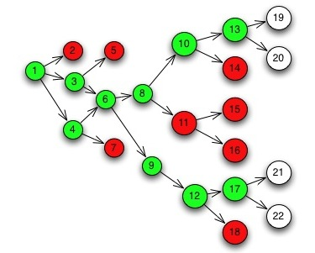
Simple

Slide 54
Simple
0
0
”Spikes” build, measure and learn by a process of elimination.
Prioritized, breadth-first, parallel, “set-based” design.

Slide 55
Simple
0
0
”Spikes” build, measure and learn by a process of elimination.
Prioritized, breadth-first, parallel, “set-based” design.

Slide 56
Simple
0
A
0
”Spikes” build, measure and learn by a process of elimination.
Prioritized, breadth-first, parallel, “set-based” design.

Slide 57
Simple
0
A
0
11
”Spikes” build, measure and learn by a process of elimination.
Prioritized, breadth-first, parallel, “set-based” design.

Slide 58
Simple
0
A
0
11
”Spikes” build, measure and learn by a process of elimination.
Prioritized, breadth-first, parallel, “set-based” design.

Slide 59
Simple
0
A
0
11
”Spikes” build, measure and learn by a process of elimination.
Prioritized, breadth-first, parallel, “set-based” design.

Slide 60
Simple
0
A
0
11
”Spikes” build, measure and learn by a process of elimination.
Prioritized, breadth-first, parallel, “set-based” design.

Slide 61
Simple
0
A
0
11
”Spikes” build, measure and learn by a process of elimination.
Prioritized, breadth-first, parallel, “set-based” design.

Slide 62
Simple

Slide 63
Simple

Slide 64
Simple

Slide 65
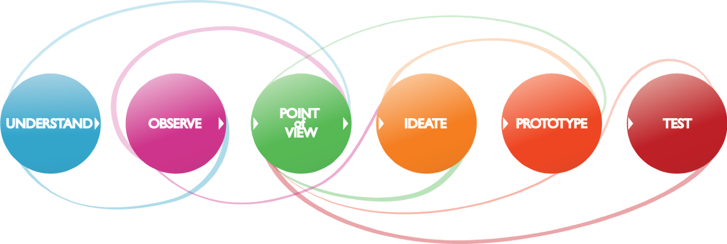
Simple
DATA
LEARN
TESTS
BUILD
CODE
MEASURE
How to refactor all this into
Jobs’ “elegance of minimal”?

Slide 66
Simple
TESTS
LEARN
BUILD
DATA
CODE
MEASURE
Notes:
What happened with “statement”?

Slide 67
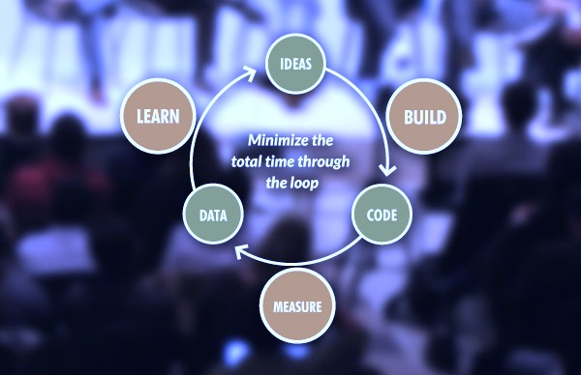
Simple
TESTS
LEARN
BUILD
REFACTOR
DATA
CODE
MEASURE
Lean Startup + BDD
Notes:
What happened with “statement”?

Slide 68
Simple Design
TESTS
LEARN
BUILD
REFACTOR
DATA
CODE
“Add value by removing that without.”
-- Ron Jeffries
“Each and every declaration of behavior
should appear once and only once.”
-- Kent Beck
“Ask, what’s the simplest thing that could possibly work?
Don’t solve problems you don't yet have.”
-- Ward Cunningham
MEASURE
Notes:
What happened with “statement”?

Slide 69
Simple Design
LEARN
TESTS
BUILD
DATA
REFACTOR
CODE
MEASURE
0
A
0
11

Slide 70
Simple Design
LEARN
TESTS
BUILD
DATA
REFACTOR
CODE
MEASURE
0
A
0
11

Slide 71
Set-Based Design Game

Slide 72
LEARN
TESTS
BUILD
DATA
REFACTOR
CODE
Design a logo for our new product!
2-person 2-minute Design Sprints.
What Acceptance Criteria did we learn?
Knock Out Alternatives via LaaS!
Refactor!
Repeat!
MEASURE
0
A
0
11

Slide 73
Continuous throughput
At any time there’s one bottleneck constraint
Work on other constraints is premature
Because it won’t increase Throughput
Throughput

Slide 74
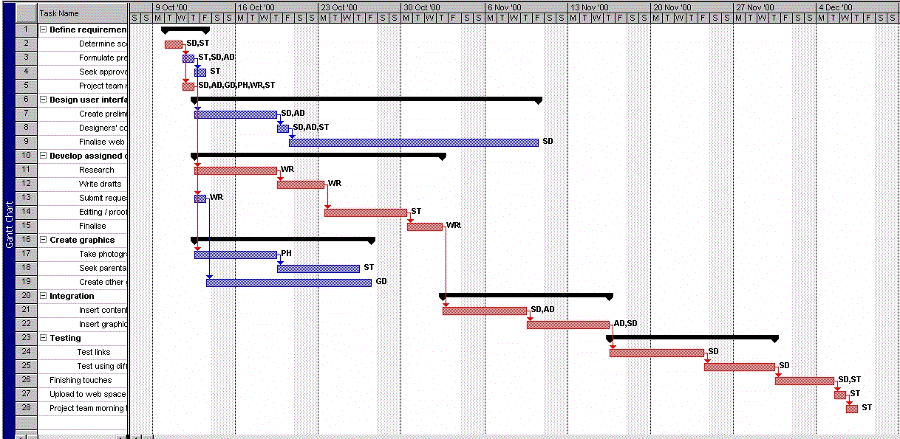
Continuous
“Tell me how you measure me and I will tell you how
I will behave. If you measure me in an illogical way
do not complain about illogical behavior.” – Eli Goldratt
Notes:
What happened with “statement”?

Slide 75
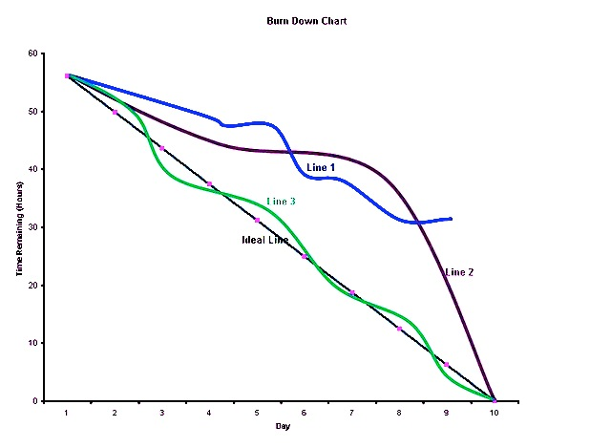
Continuous
Same Gantt Chart
Different Throughput.
Continuous optimization of throughput
prevents illogical behavior.
Notes:
What happened with “statement”?

Slide 76
Continuous
Notes:
What happened with “statement”?

Slide 77
Continuous
Mura
(Wobble)
Muri
(Overburden)
Muda
(Waste)
Notes:
What happened with “statement”?

Slide 78
Continuous
Mura
(Wobble)
Same Burnup Chart.
Different Throughput.
What are we missing?
Technical
Debt
Notes:
What happened with “statement”?

Slide 79
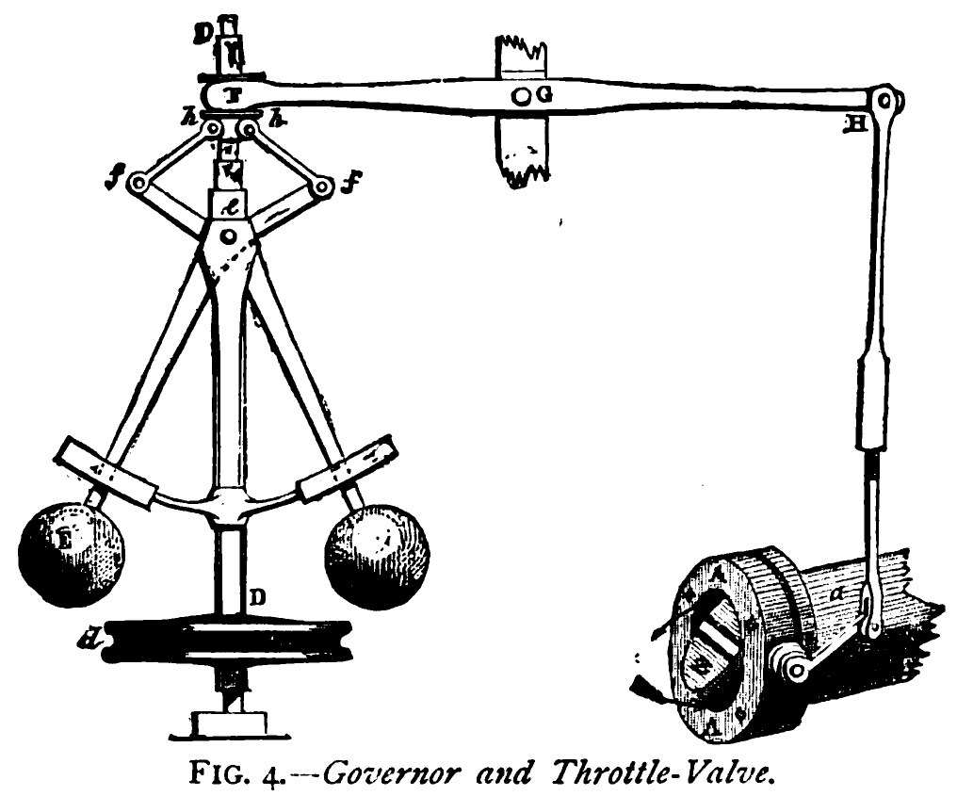
Continuous
Industrial machines
use metric feedback
loops to continuously
optimize throughput.
Notes:
What happened with “statement”?

Slide 80
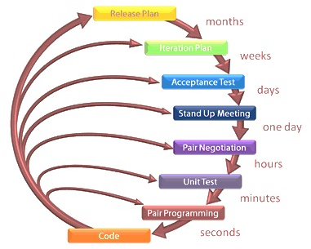
Continuous
1G Agile is a feedback machine for small IT delivery teams.
Beck’s Maxim: “Turn all the knobs to ten.”
The knobs are continuous feedback loops.
Notes:
What happened with “statement”?

Slide 81
Continuous
Story Backlog x Velocity
System Integration Testing
Continuous Integration
Feature Integration Testing
Which one of these curves is throughput?
Notes:
What happened with “statement”?

Slide 82
Continuous
System Integration Testing
Story Backlog x Velocity
BDD-Covered Features
Return?
Feature Budgets & Priorities
Operating Expense / Investment
Continuous Integration
Feature Integration Testing
By themselves, stories don’t generate throughput. Features do.
Notes:
What happened with “statement”?

Slide 83
Notes:
What happened with “statement”?

Slide 84
Metric
Criterion
Rate
Return
Acquisition | Starts App / Clicks Past 1st Page
Acquisition | Views 2+ Screens for 10+ Secs
Activation | Email/FB/Google Signup
Activation | Adds Profile Data
Retention | 3+ Visits in 1st 30 Days
Retention | Email/RSS Subscription
Referral | Shares Contacts
Referral | Refers +1 Users Who Activate
Revenue | One-Off Purchase
Revenue | Billing Subscription
100%
$1.00
90%
$1.10
80%
$1.30
70%
$1.50
60%
$1.75
50%
$2.00
40%
$2.50
30%
$3.00
20%
$5.00
10%
$10.00
Notes:
What happened with “statement”?

Slide 85
Metric
Criterion
Rate
Return
Acquisition | Starts App / Clicks Past 1st Page
Acquisition | Views 2+ Screens for 10+ Secs
Activation | Email/FB/Google Signup
Activation | Adds Profile Data
Retention | 3+ Visits in 1st 30 Days
Retention | Email/RSS Subscription
Referral | Shares Contacts
Referral | Refers +1 Users Who Activate
Revenue | One-Off Purchase
Revenue | Billing Subscription
50%
$0.50
45%
$0.60
80%
$1.30
70%
$1.50
60%
$1.75
50%
$2.00
40%
$2.50
30%
$3.00
20%
$5.00
10%
$10.00
Notes:
What happened with “statement”?

Slide 86
Metric
Criterion
Rate
Return
Acquisition | Starts App / Clicks Past 1st Page
Acquisition | Views 2+ Screens for 10+ Secs
Activation | Email/FB/Google Signup
Activation | Adds Profile Data
Retention | 3+ Visits in 1st 30 Days
Retention | Email/RSS Subscription
Referral | Shares Contacts
Referral | Refers +1 Users Who Activate
Revenue | One-Off Purchase
Revenue | Billing Subscription
50%
$0.50
45%
$0.60
40%
$0.70
35%
$0.80
30%
$0.90
25%
$1.00
20%
$1.25
15%
$1.50
10%
$2.50
5%
$5.00
Notes:
What happened with “statement”?

Slide 87
Metric
Criterion
Rate
Return
Acquisition | Starts App / Clicks Past 1st Page
Acquisition | Views 2+ Screens for 10+ Secs
Activation | Email/FB/Google Signup
Activation | Adds Profile Data
Retention | 3+ Visits in 1st 30 Days
Retention | Email/RSS Subscription
Referral | Shares Contacts
Referral | Refers +1 Users Who Activate
Revenue | One-Off Purchase
Revenue | Billing Subscription
100%
$1.00
90%
$1.10
80%
$1.30
70%
$1.50
60%
$1.75
50%
$2.00
40%
$2.50
30%
$3.00
20%
$5.00
10%
$10.00
Notes:
What happened with “statement”?

Slide 88
Metric
Criterion
Rate
Return
Acquisition | Starts App / Clicks Past 1st Page
Acquisition | Views 2+ Screens for 10+ Secs
Activation | Email/FB/Google Signup
Activation | Adds Profile Data
Retention | 3+ Visits in 1st 30 Days
Retention | Email/RSS Subscription
Referral | Shares Contacts
Referral | Refers +1 Users Who Activate
Revenue | One-Off Purchase
Revenue | Billing Subscription
100%
$1.00
90%
$1.10
40%
$0.70
35%
$0.80
60%
$1.75
50%
$2.00
40%
$2.50
30%
$3.00
20%
$5.00
10%
$10.00
Notes:
What happened with “statement”?

Slide 89
Metric
Criterion
Rate
Return
Acquisition | Starts App / Clicks Past 1st Page
Acquisition | Views 2+ Screens for 10+ Secs
Activation | Email/FB/Google Signup
Activation | Adds Profile Data
Retention | 3+ Visits in 1st 30 Days
Retention | Email/RSS Subscription
Referral | Shares Contacts
Referral | Refers +1 Users Who Activate
Revenue | One-Off Purchase
Revenue | Billing Subscription
100%
$1.00
90%
$1.10
40%
$0.70
35%
$0.80
30%
$0.90
25%
$1.00
20%
$1.25
15%
$1.50
10%
$2.50
5%
$5.00
Notes:
What happened with “statement”?

Slide 90
Metric
Criterion
Rate
Return
Acquisition | Starts App / Clicks Past 1st Page
Acquisition | Views 2+ Screens for 10+ Secs
Activation | Email/FB/Google Signup
Activation | Adds Profile Data
Retention | 3+ Visits in 1st 30 Days
Retention | Email/RSS Subscription
Referral | Shares Contacts
Referral | Refers +1 Users Who Activate
Revenue | One-Off Purchase
Revenue | Billing Subscription
100%
$1.00
90%
$1.10
80%
$1.30
70%
$1.50
60%
$1.75
50%
$2.00
40%
$2.50
30%
$3.00
20%
$5.00
10%
$10.00
Notes:
What happened with “statement”?

Slide 91
Metric
Criterion
Rate
Return
Acquisition | Starts App / Clicks Past 1st Page
Acquisition | Views 2+ Screens for 10+ Secs
Activation | Email/FB/Google Signup
Activation | Adds Profile Data
Retention | 3+ Visits in 1st 30 Days
Retention | Email/RSS Subscription
Referral | Shares Contacts
Referral | Refers +1 Users Who Activate
Revenue | One-Off Purchase
Revenue | Billing Subscription
100%
$1.00
90%
$1.10
80%
$1.30
70%
$1.50
30%
$0.90
25%
$1.00
40%
$2.50
30%
$3.00
20%
$5.00
10%
$10.00
Notes:
What happened with “statement”?

Slide 92
Metric
Criterion
Rate
Return
Acquisition | Starts App / Clicks Past 1st Page
Acquisition | Views 2+ Screens for 10+ Secs
Activation | Email/FB/Google Signup
Activation | Adds Profile Data
Retention | 3+ Visits in 1st 30 Days
Retention | Email/RSS Subscription
Referral | Shares Contacts
Referral | Refers +1 Users Who Activate
Revenue | One-Off Purchase
Revenue | Billing Subscription
100%
$1.00
90%
$1.10
80%
$1.30
70%
$1.50
30%
$0.90
25%
$1.00
20%
$1.25
15%
$1.50
10%
$2.50
5%
$5.00
Notes:
What happened with “statement”?

Slide 93
Metric
Criterion
Rate
Return
Acquisition | Starts App / Clicks Past 1st Page
Acquisition | Views 2+ Screens for 10+ Secs
Activation | Email/FB/Google Signup
Activation | Adds Profile Data
Retention | 3+ Visits in 1st 30 Days
Retention | Email/RSS Subscription
Referral | Shares Contacts
Referral | Refers +1 Users Who Activate
Revenue | One-Off Purchase
Revenue | Billing Subscription
100%
$1.00
90%
$1.10
80%
$1.30
70%
$1.50
30%
$0.90
25%
$1.00
20%
$1.25
15%
$1.50
10%
$2.50
5%
$5.00
Notes:
What happened with “statement”?

Slide 94
Metric
Criterion
Rate
Return
Acquisition | Starts App / Clicks Past 1st Page
Acquisition | Views 2+ Screens for 10+ Secs
Activation | Email/FB/Google Signup
Activation | Adds Profile Data
Retention | 3+ Visits in 1st 30 Days
Retention | Email/RSS Subscription
Referral | Shares Contacts
Referral | Refers +1 Users Who Activate
Revenue | One-Off Purchase
Revenue | Billing Subscription
100%
$1.00
90%
$1.10
80%
$1.30
70%
$1.50
60%
$1.75
50%
$2.00
40%
$2.50
30%
$3.00
20%
$5.00
10%
$10.00
Notes:
What happened with “statement”?

Slide 95
Metric
Criterion
Rate
Return
Acquisition | Starts App / Clicks Past 1st Page
Acquisition | Views 2+ Screens for 10+ Secs
Activation | Email/FB/Google Signup
Activation | Adds Profile Data
Retention | 3+ Visits in 1st 30 Days
Retention | Email/RSS Subscription
Referral | Shares Contacts
Referral | Refers +1 Users Who Activate
Revenue | One-Off Purchase
Revenue | Billing Subscription
100%
$1.00
90%
$1.10
80%
$1.30
70%
$1.50
60%
$1.75
50%
$2.00
20%
$1.25
15%
$1.50
20%
$5.00
10%
$10.00
Notes:
What happened with “statement”?

Slide 96
Metric
Criterion
Rate
Return
Acquisition | Starts App / Clicks Past 1st Page
Acquisition | Views 2+ Screens for 10+ Secs
Activation | Email/FB/Google Signup
Activation | Adds Profile Data
Retention | 3+ Visits in 1st 30 Days
Retention | Email/RSS Subscription
Referral | Shares Contacts
Referral | Refers +1 Users Who Activate
Revenue | One-Off Purchase
Revenue | Billing Subscription
100%
$1.00
90%
$1.10
80%
$1.30
70%
$1.50
60%
$1.75
50%
$2.00
20%
$1.25
15%
$1.50
10%
$2.50
5%
$5.00
Notes:
What happened with “statement”?

Slide 97
Metric
Criterion
Rate
Return
Acquisition | Starts App / Clicks Past 1st Page
Acquisition | Views 2+ Screens for 10+ Secs
Activation | Email/FB/Google Signup
Activation | Adds Profile Data
Retention | 3+ Visits in 1st 30 Days
Retention | Email/RSS Subscription
Referral | Shares Contacts
Referral | Refers +1 Users Who Activate
Revenue | One-Off Purchase
Revenue | Billing Subscription
100%
$1.00
90%
$1.10
80%
$1.30
70%
$1.50
60%
$1.75
50%
$2.00
40%
$2.50
30%
$3.00
20%
$5.00
10%
$10.00
Notes:
What happened with “statement”?

Slide 98
Metric
Criterion
Rate
Return
Acquisition | Starts App / Clicks Past 1st Page
Acquisition | Views 2+ Screens for 10+ Secs
Activation | Email/FB/Google Signup
Activation | Adds Profile Data
Retention | 3+ Visits in 1st 30 Days
Retention | Email/RSS Subscription
Referral | Shares Contacts
Referral | Refers +1 Users Who Activate
Revenue | One-Off Purchase
Revenue | Billing Subscription
100%
$1.00
90%
$1.10
80%
$1.30
70%
$1.50
60%
$1.75
50%
$2.00
40%
$2.50
30%
$3.00
10%
$2.50
10%
$10.00
Notes:
What happened with “statement”?

Slide 99
Metric
Criterion
Rate
Return
Acquisition | Starts App / Clicks Past 1st Page
Acquisition | Views 2+ Screens for 10+ Secs
Activation | Email/FB/Google Signup
Activation | Adds Profile Data
Retention | 3+ Visits in 1st 30 Days
Retention | Email/RSS Subscription
Referral | Shares Contacts
Referral | Refers +1 Users Who Activate
Revenue | One-Off Purchase
Revenue | Billing Subscription
100%
$1.00
90%
$1.10
80%
$1.30
70%
$1.50
60%
$1.75
50%
$2.00
40%
$2.50
30%
$3.00
10%
$2.50
5%
$5.00
Notes:
What happened with “statement”?

Slide 100
Metric
Criterion
Rate
Return
Acquisition | Starts App / Clicks Past 1st Page
Acquisition | Views 2+ Screens for 10+ Secs
Activation | Email/FB/Google Signup
Activation | Adds Profile Data
Retention | 3+ Visits in 1st 30 Days
Retention | Email/RSS Subscription
Referral | Shares Contacts
Referral | Refers +1 Users Who Activate
Revenue | One-Off Purchase
Revenue | Billing Subscription
100%
$1.00
90%
$1.10
80%
$1.30
70%
$1.50
60%
$1.75
50%
$2.00
40%
$2.50
30%
$3.00
20%
$5.00
10%
$10.00
Notes:
What happened with “statement”?

Slide 101
Continuous
Notes:
What happened with “statement”?

Slide 102
Continuous
There is no fixed cost per unit of return
Notes:
What happened with “statement”?

Slide 103
“Top Line” Return
BDD-Covered Features
Story Backlog x Velocity
Feature Budgets & Priorities
Continuous Integration
Feature Integration Testing
Operating Expense
Truly
Variable
Costs
Net
Profit
System Integration Testing
Revenue
Throughput
Operating
Expense
Notes:
What happened with “statement”?

Slide 104
Continuous
Truly
Variable
Costs
Net
Profit
NP
Revenue
Throughput
Operating
Expense
Notes:
What happened with “statement”?

Slide 105
Continuous
Truly
Variable
Costs
Net
Profit
Revenue
Throughput
Operating
Expense
Notes:
What happened with “statement”?

Slide 106
Continuous
Truly
Variable
Costs
NP
Continuously
Prioritize Design to
Open the Bottleneck
Lift a pirate constraint
Net
Profit
Revenue
Throughput
Operating
Expense
Notes:
What happened with “statement”?

Slide 107
Continuous
Truly
Variable
Costs
NP
Continuously
Prioritize Design to
Open the Bottleneck
Lift a pirate constraint
Cut Operating Expense
Net
Profit
Revenue
Throughput
NP
Operating
Expense
Notes:
What happened with “statement”?

Slide 108
Continuous
Truly
Variable
Costs
NP
Net
Profit
Continuously
Prioritize Design to
Open the Bottleneck
Lift a pirate constraint
Cut Operating Expense
Lift Efficiency
Revenue
Throughput
Operating
Expense
Notes:
What happened with “statement”?

Slide 109
Truly
Variable
Costs
Continuous
Net
Profit
NP
Continuously
Prioritize Design to
Open the Bottleneck
Lift a pirate constraint
Cut operating expense
Lift Efficiency
Capture a new market
Open a new ecosystem
Revenue
Throughput
Operating
Expense
Notes:
What happened with “statement”?

Slide 110
Three Minty Machines

Slide 111
Minty Machine 1: form teams of 2-5 people
Each to “process” 10 Minties.
Each flips all 10 Minties before passing.
No air but each player can use both hands.
Use a stop watch to time each person.
Record who’s best and how long end to end.

Slide 112
Minty Machine 2: same teams
Handicap – use only one hand.
Also more passes - pass as each is flipped.
Coordinator to call out seconds.
Each person to time themselves.
Record who’s best and how long end to end.
Why was that faster end to end?

Slide 113
Autonomous Teams
Self-managing teams don’t have masters
Self-aligning streams don’t have owners
Leadership as a Service + Chapter Meetings

Slide 114
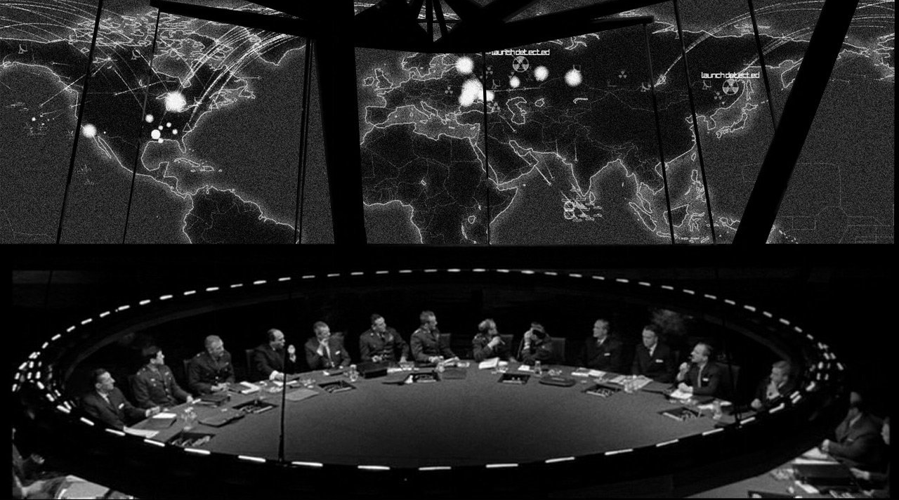
Autonomous
Picture a system out of control.
No plan survives contact with the enemy.
– Von Moltke
Notes:
What happened with “statement”?

Slide 115
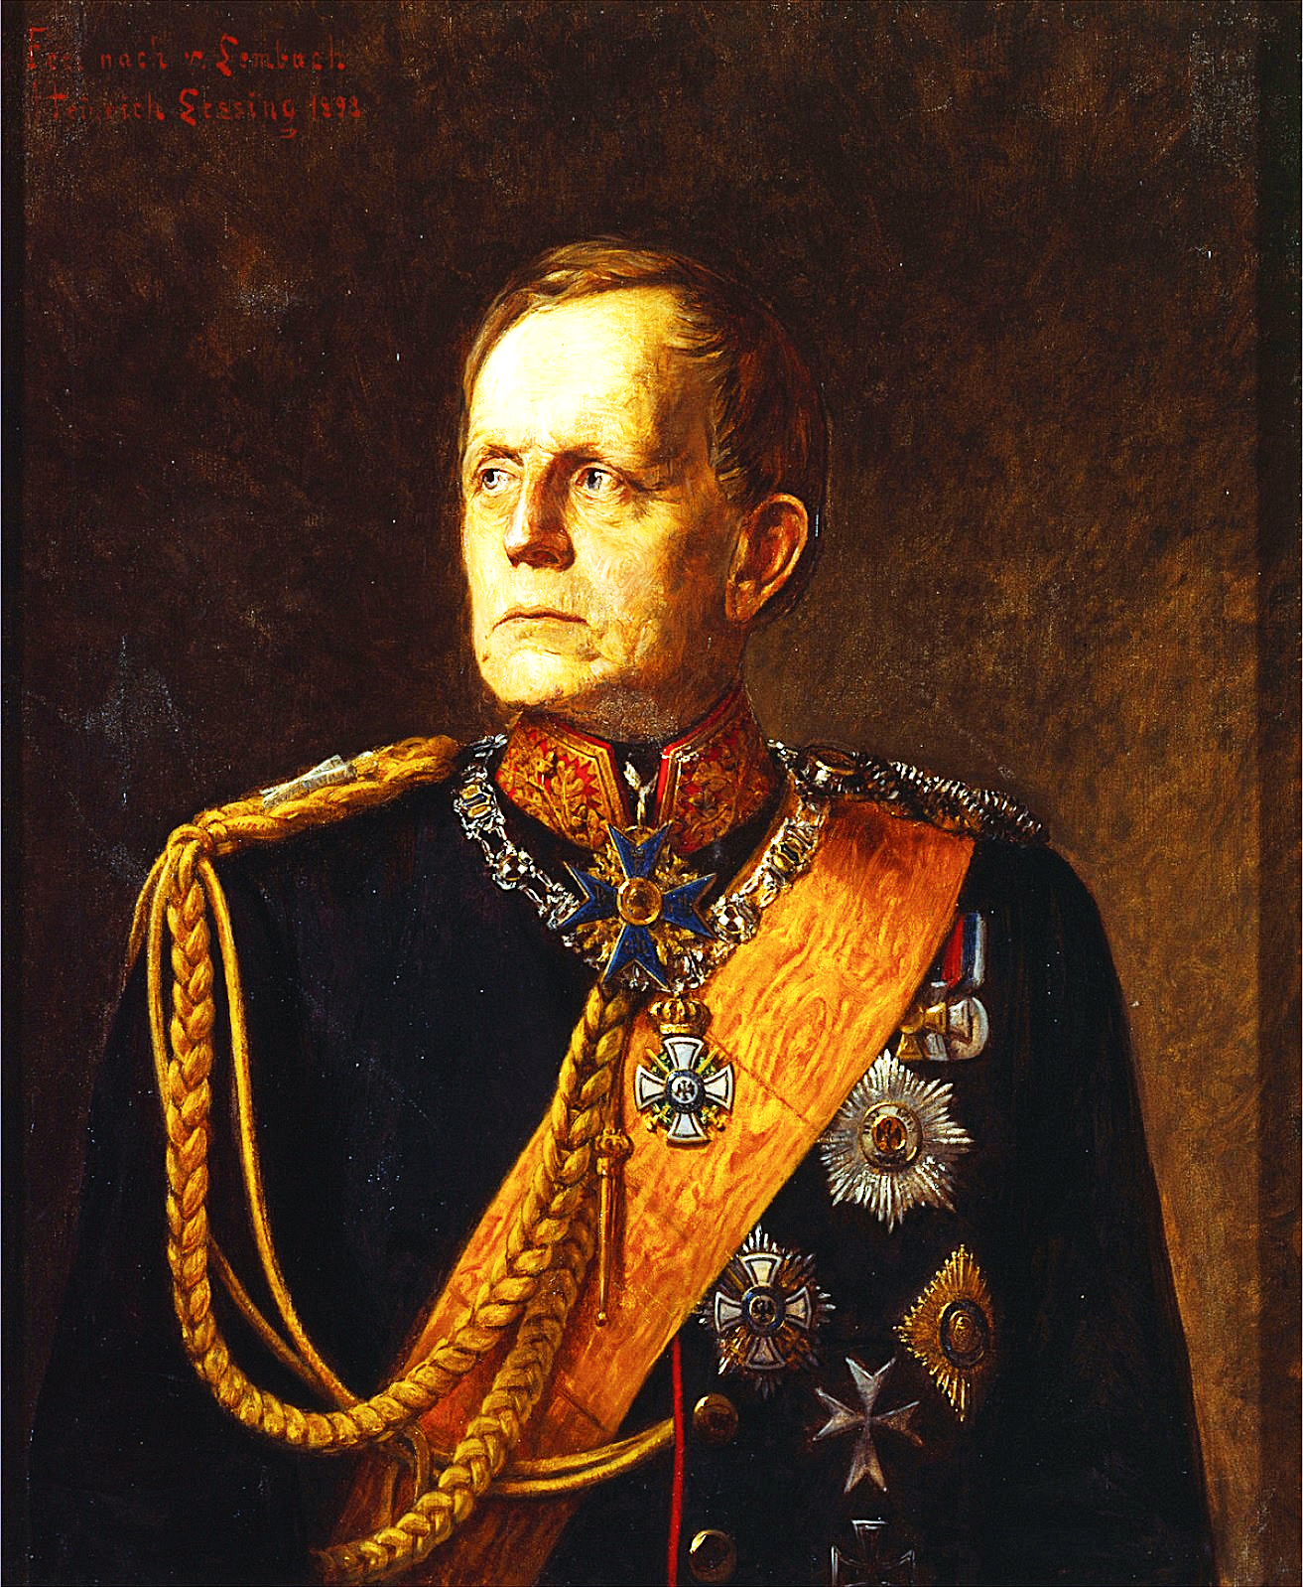
Autonomous
Mission Command
“No plan survives contact with the enemy.
Each officer must act on the basis of his own
view of the situation. All productive action is
controlled by a superior framework of intent.”
-- Field Marshal Helmut Von Moltke, Chief
General of the Prussian Army 1857–1888
Notes:
What happened with “statement”?

Slide 116
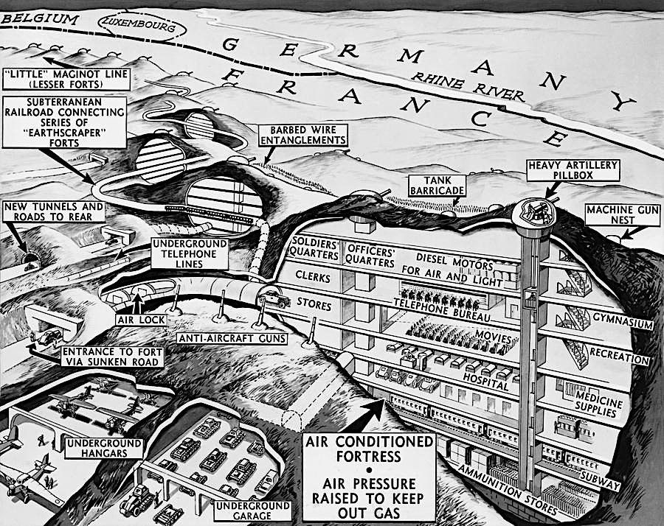
Autonomous

Slide 117
Autonomous
Mission Command “Auftragstaktik” overcame the Maginot Line in just 5 days.

Slide 118
Autonomous
The Royal Navy used huge convoys to guard against lone submarines.

Slide 119
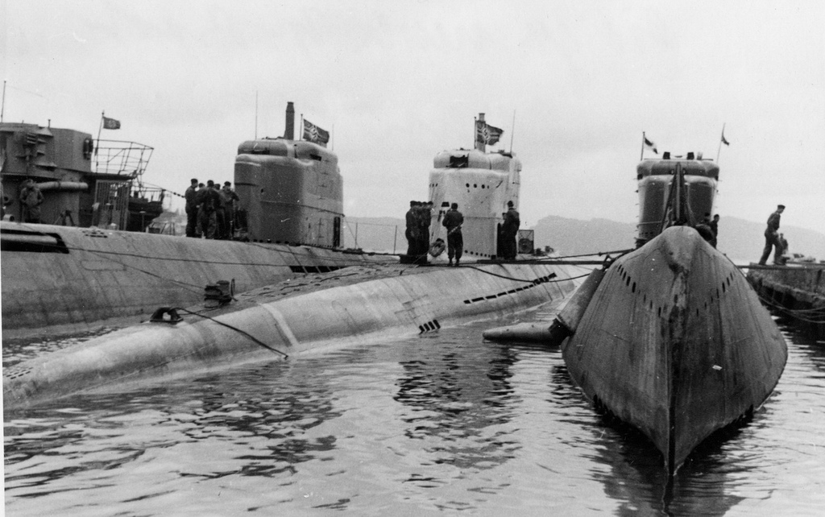
Autonomous
“Auftragstaktik” U-Boats decimated Royal Navy convoys by attacking in packs at night.

Slide 120
Autonomous
What else is wrong with this picture?
1. Too many people in the room.
2. Terrible Collaboration Loop Limit.
Notes:
What happened with “statement”?

Slide 121
Managed Team
Team Size: 7
Collaboration Loop Limit:

Slide 122
Managed Team
Team Size: 7
Collaboration Loop Limit:

Slide 123
Managed Team
Team Size: 7
Collaboration Loop Limit:

Slide 124
Managed Team
Team Size: 7
Collaboration Loop Limit: 1

Slide 125
Managed Team
Team Size: 7
Collaboration Loop Limit: 2

Slide 126
Managed Team
Team Size: 7
Collaboration Loop Limit: 3

Slide 127
Managed Team
Team Size: 7
Collaboration Loop Limit: 4

Slide 128
Managed Team
Team Size: 7
Collaboration Loop Limit: 4

Slide 129
Managed Program
Team Size: 43
Collaboration Loop Limit:

Slide 130
Managed Program
Team Size: 43
Collaboration Loop Limit:

Slide 131
Managed Program
Team Size: 43
Collaboration Loop Limit: 1

Slide 132
Managed Program
Team Size: 43
Collaboration Loop Limit: 2

Slide 133
Managed Program
Team Size: 43
Collaboration Loop Limit: 3

Slide 134
Managed Program
Team Size: 43
Collaboration Loop Limit: 4

Slide 135
Managed Program
Team Size: 43
Collaboration Loop Limit: 5

Slide 136
Managed Program
Team Size: 43
Collaboration Loop Limit: 6

Slide 137
Managed Program
Team Size: 43
Collaboration Loop Limit: 7

Slide 138
Managed Program
Team Size: 43
Collaboration Loop Limit: 8

Slide 139
Managed Program
Team Size: 43
Collaboration Loop Limit: 8

Slide 140
Program/Portfolio Management Office (“PMO”)
Team Size: 259
Collaboration Loop Limit: 12

Slide 141
Program/Portfolio Management Office (“PMO”)
Team Size: 259
Collaboration Loop Limit: 12

Slide 142
Enterprise Project Management Office (“EPMO”)
Team Size: 1,555
Collaboration Loop Limit: 16

Slide 143
Autonomous
US Military Collaboration Loop Limit:
… um ...
Notes:
What happened with “statement”?

Slide 144

Hierarchy holarchy is hole in it
© Peter Merel, 2016

Slide 145
Holarchy
is Hierarchy
with a Hole in it
© Peter Merel, 2016

Slide 146
Autonomous Squad
Team Size: 6
Collaboration Loop Limit: 2

Slide 147
Autonomous Squad
Prioritization + Pairing

Slide 148
Autonomous Squad
Prioritization + Pairing

Slide 149
Autonomous Squad
Prioritization + Pairing

Slide 150
Autonomous Squad
Prioritization + Pairing

Slide 151
Autonomous Squad
Prioritization + Pairing

Slide 152
Autonomous Squad
Prioritization + Pairing

Slide 153
Autonomous Squad
Prioritization + Pairing

Slide 154
Can autonomy scale without hierarchy?

Slide 155
Autonomous Value Stream

Slide 156
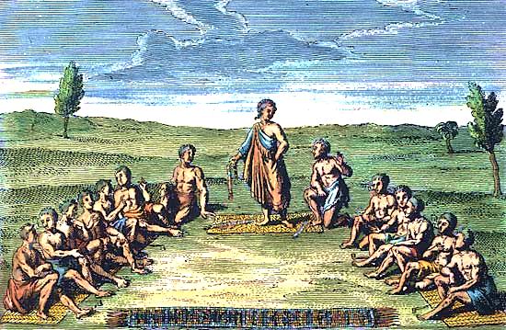
Truly
Variable
Costs
REFACTOR
Net
Profit
Product Squad
NP
Revenue
Throughput
Feature Squads
Operating
Expense
Notes:
What happened with “statement”?

Slide 157
Autonomous
Leadership as a Service
Split management into three parts: Coach, Leader and Team.
Coach maintains timeframe and ceremonies for making decisions.
Feature Squads
If and only if the Team isn’t unanimous, the Leader decides.
NP
REFACTOR
Motivating trade-offs to achieve consensus without politics.
The Iroquois “Great Law of Peace”
The Leader role ensures decisions are always made in good time.
Notes:
What happened with “statement”?

Slide 158
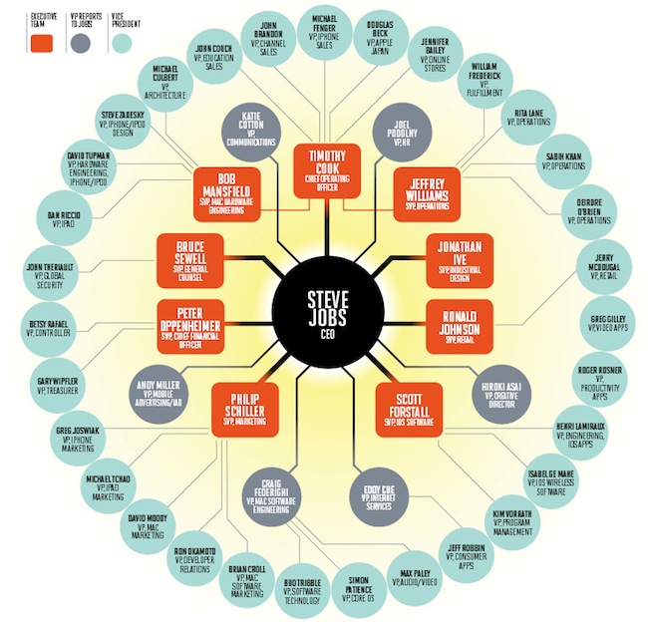
Autonomous
Leadership as a Service
Split management into three parts: Coach, Leader and Team.
Coach maintains timeframe and ceremonies for making decisions.
If and only if the Team isn’t unanimous, the Leader decides.
REFACTOR
Motivating trade-offs to achieve consensus without politics.
The Iroquois “Great Law of Peace”
The Leader role ensures decisions are always made in good time.
Notes:
What happened with “statement”?

Slide 159
Autonomous
Leadership as a Service
Split management into three parts: Coach, Leader and Team.
Coach maintains timeframe and ceremonies for making decisions.
If and only if the Team isn’t unanimous, the Leader decides.
REFACTOR
Motivating trade-offs to achieve consensus without politics.
“DRI”s
The Iroquois “Great Law of Peace”
The Leader role ensures decisions are always made in good time.
Notes:
What happened with “statement”?

Slide 160
Autonomous
Value Streams
Chapter Leaders
Squad: 4 - 8 people
Chapter: 2 - 10 people
Portfolio: 10 - 100 people
Stakeholders
Product Squads
Business SMEs
Customer Reps
DevOps SMEs
Product Leaders & Coaches
Portfolio Leader
Maximum
Portfolio Coach
Analysts
Portfolio Squad
Feature Squads
Testers
Designers
NP
REFACTOR
Developers
Systems Leaders & Coaches
Chapters
Quality Automation
Systems Squads
Process Automation
Production Support
© Peter Merel, 2016
Notes:
What happened with “statement”?

Slide 161
Autonomous
Value Streams
Chapter Leaders
Squad: 4 - 8 people
Chapter: 2 - 10 people
Portfolio: 10 - 100 people
Stakeholders
Product Squads
Business SMEs
Customer Reps
DevOps SMEs
Product Leaders & Coaches
Portfolio Leader
Portfolio Coach
Business & Technology Guilds
Analysts
Portfolio Squad
Testers
Leadership Guild
Feature Squads
Designers
Coaching Guild
NP
Transformation Leader & Coach
REFACTOR
Developers
Systems Leaders & Coaches
Chapters
Quality Automation
Systems Squads
Process Automation
Production Support
…
© Peter Merel, 2016
Portfolio 2
Portfolio 3
Leadership as a Service is the key enabler for holarchy because …
Notes:
What happened with “statement”?

Slide 162
Autonomous
Value Streams
Chapter Leaders
Squad: 4 - 8 people
Chapter: 2 - 10 people
Portfolio: 10 - 100 people
Stakeholders
Product Squads
Business SMEs
Customer Reps
DevOps SMEs
Product Leaders & Coaches
Portfolio Leader
Portfolio Coach
Business & Technology Guilds
Analysts
Portfolio Squad
Testers
Leadership Guild
Feature Squads
Designers
Coaching Guild
Developers
Transformation Leader & Coach
Systems Leaders & Coaches
Chapters
Quality Automation
Systems Squads
Process Automation
Production Support
…
© Peter Merel, 2016
Portfolio 2
Portfolio 3
Portfolio Collaboration Loop Limit: 4
Notes:
What happened with “statement”?

Slide 163
Autonomous
Value Streams
Chapter Leaders
Squad: 4 - 8 people
Chapter: 2 - 10 people
Portfolio: 10 - 100 people
Stakeholders
Product Squads
Business SMEs
Customer Reps
DevOps SMEs
Product Leaders & Coaches
Portfolio Leader
Portfolio Coach
Business & Technology Guilds
Analysts
Portfolio Squad
Testers
Leadership Guild
Feature Squads
Designers
Coaching Guild
Developers
Transformation Leader & Coach
Systems Leaders & Coaches
Chapters
Quality Automation
Systems Squads
Process Automation
Production Support
…
© Peter Merel, 2016
Portfolio 2
Portfolio 3
Portfolio Collaboration Loop Limit: 4
Notes:
What happened with “statement”?

Slide 164
Autonomous
Stakeholders
Business SMEs
Product Squads
Customer Reps
DevOps SMEs
Analysts
Portfolio Squad
Feature Squads
Testers
Designers
Developers
Quality Automation
Systems Squads
Process Automation
Production Support
© Peter Merel, 2016
Notes:
What happened with “statement”?

Slide 165
Autonomous
Stakeholders
Business SMEs
Customer Reps
DevOps SMEs
Analysts
Testers
Designers
Developers
Quality Automation
Process Automation
Production Support
© Peter Merel, 2016
Notes:
What happened with “statement”?

Slide 166
Triple loop Learning
Learning Flow –> Work Flow –> Value Flow
Self-Organizing Transformation: Steel Threads
Continuous Delivery x Continuous Learning
Build
Measure
Learn
Refactor
Learning Flow
Value Flow
Work Flow

Slide 167
The Business Agility Game

Slide 168
The Business Agility Game
Form Teams of 5.
Each person represents a Pirate Metric.
To start, each is constrained to 1 Minty/turn.
You can’t pass more Minties than you get.
Except: Referral creates N Minties for every
Minty that gets Retained. It passes to Activation.
Before each turn each person flips a coin.
Heads increases your constraint by +1.
50% of Revenue can be applied to open any
Constraint(s). The rest is Net Profit.
Acquisition
Activation
Retention
Referral
Revenue
Net
Profit
OpEx

Slide 169
Run 5 Releases in 5 Minutes.
Now try it where you don’t know your coin
flip analytics until after allocating OpEx.
Now try having OpEx allocations by a PO who can’t
see flip analytics or card constraints, only Net Profit.
This is why Continuous Learning, Open Book
Management & Bottleneck Prioritization are critical
to Business Agility. And why OpEx minimization isn’t.
Acquisition
Activation
Retention
Referral
Revenue
Net
Profit
OpEx

Slide 170
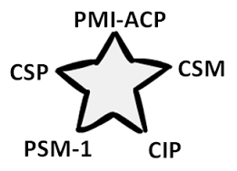









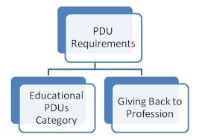

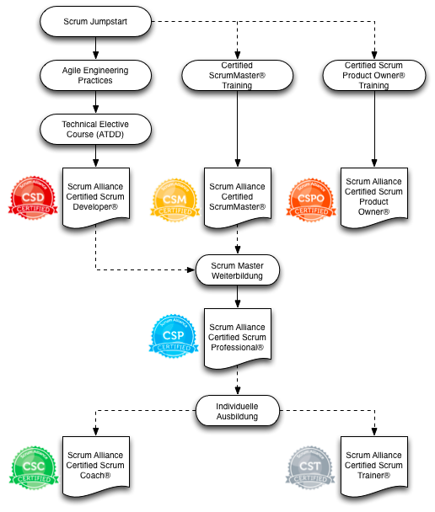



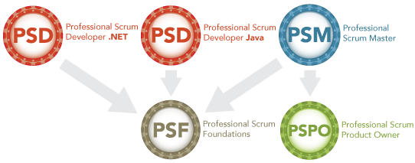











Learning
Certification isn’t how
organizations learn
Notes:
What happened with “statement”?

Slide 171
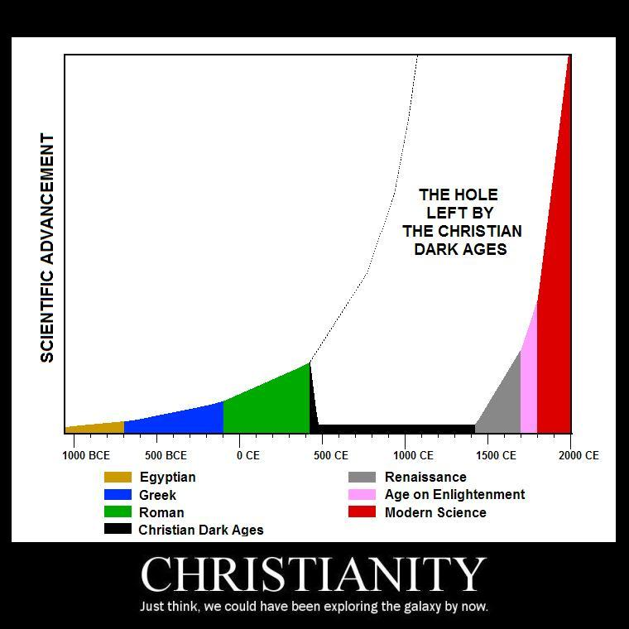
Learning
Entropic
Empire
Learning doesn’t standardize understanding.
Learning obsoletes understanding.
Notes:
What happened with “statement”?

Slide 172
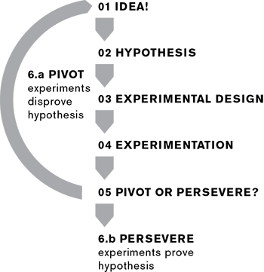
Learning
LEARN
BUILD
MEASURE
Lean Startup is single loop learning. Startups need
profitability, not productivity. They learn fast or die slow.
Notes:
What happened with “statement”?

Slide 173
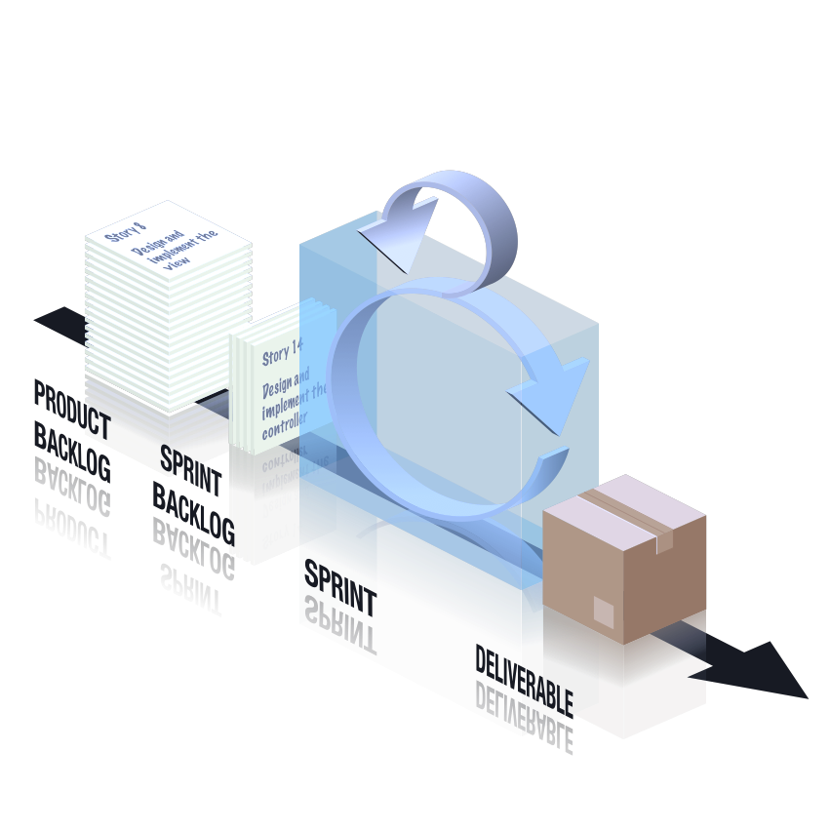
Learning
RETROSPECTIVE
SPRINT
Autonomy
Scrum is double-loop learning.
It learns what products to deliver, and how.
Alignment
Notes:
What happened with “statement”?

Slide 174
Build
Measure
Learn
Refactor
Learning Flow
Value Flow
Work Flow
Copyright © Peter Merel 2017
Learning flow accelerates work flow
which accelerates value flow.
Notes:
The relationship between process, team structure, and value stream function.
Processes
Impact Mapping
Acceptability Matrix
Backlog Bingo
Release Refactoring
Story Mapping
Scrumban
BDD
CD
Structure
Strategic Execution
Strategy Mapping

Slide 175
Triple Loop means we treat learning as a product
and the whole organization as its ecosystem.
Notes:
The relationship between process, team structure, and value stream function.
Processes
Impact Mapping
Acceptability Matrix
Backlog Bingo
Release Refactoring
Story Mapping
Scrumban
BDD
CD
Structure
Strategic Execution
Strategy Mapping

Slide 176
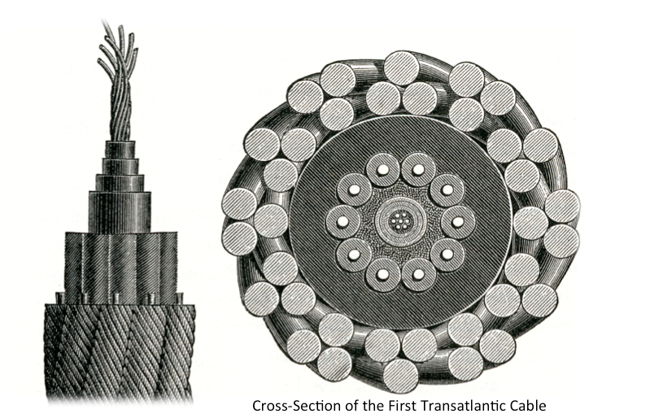
How does an organization learn the 3rd loop without
compromise, confusion and loss of control?
We can’t stop and change everything at once!
Learn Agile using Agile. Make a steel thread stream, a slender but
uncompromised capability. Then exponentially split and double.
Learning
Cross-Section of the first Transatlantic Cable
Notes:
What happened with “statement”?

Slide 177
Learning
Alignment
Autonomy

Slide 178
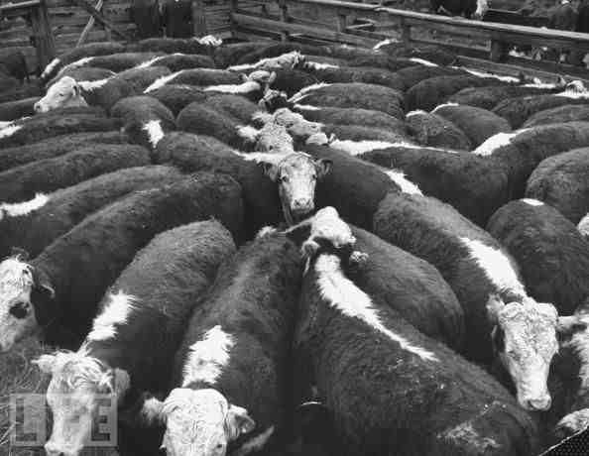
Learning
Alignment
THWADI*
Autonomy
(* That’s How We Always Do It)

Slide 179
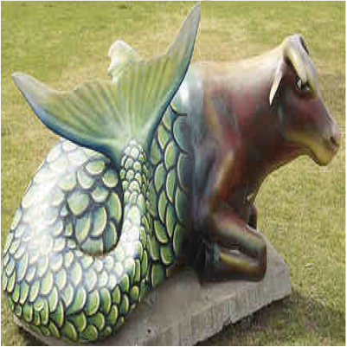
Learning
Alignment
THWADI
THWADI + Agile
Autonomy
Half a Cow and Half a Fish

Slide 180
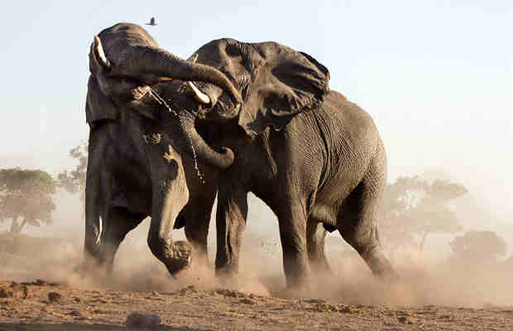
Learning
“Scaling” Agile
Alignment
THWADI
THWADI + Agile
Autonomy
Align Agile teams to a THWADI Organization

Slide 181
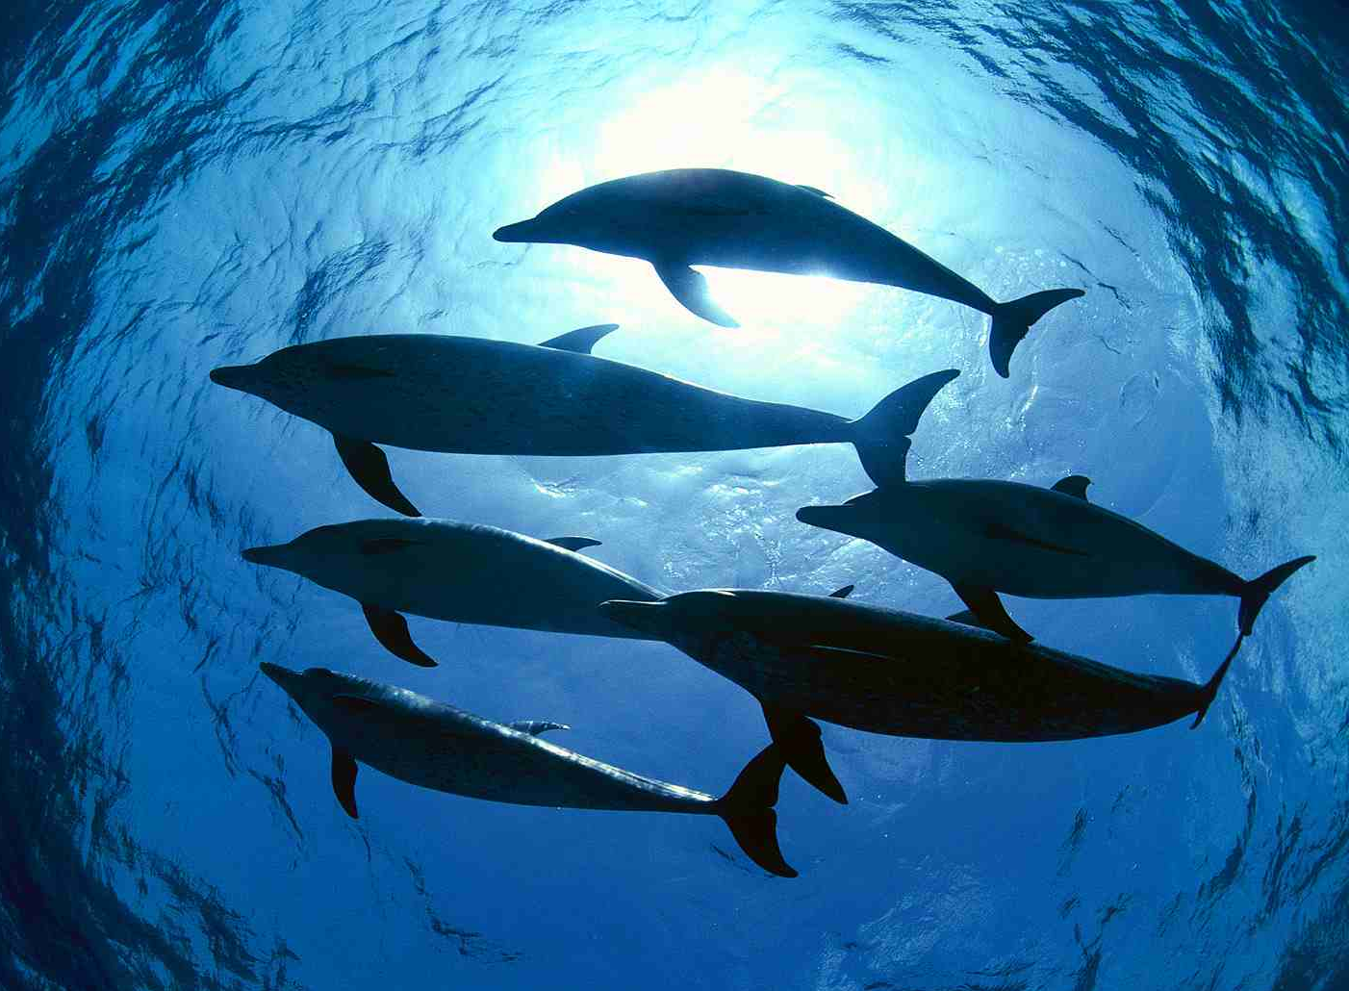
Learning
“Scaling” Agile
Descaling Organization
Alignment
THWADI
THWADI + Agile
Autonomy
Copyright © Peter Merel 2017
Refactoring the organization into self-aligning streams of self-organizing teams
Continuously, exponentially transforming change recipients into change agents.

Slide 182


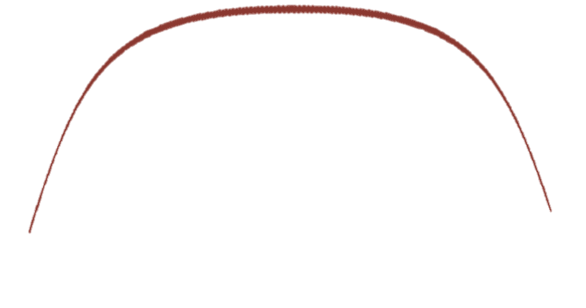




Learning
Exponential Transformation
Big Transformation Up Front
Disruption
Technical Debt
Time
Time
Autonomy
Throughput
Time
Time
And what do we do when throughput hits a bottleneck?

Slide 183
Autonomous
Value Streams
Chapter Leaders
Squad: 4 - 8 people
Chapter: 2 - 10 people
Portfolio: 10 - 100 people
Stakeholders
Product Squads
Business SMEs
Customer Reps
DevOps SMEs
Product Leaders & Coaches
Portfolio Leader
Portfolio Coach
Business & Technology Guilds
Analysts
Portfolio Squad
Testers
Leadership Guild
Feature Squads
Designers
Coaching Guild
Developers
Transformation Leader & Coach
Systems Leaders & Coaches
Chapters
Quality Automation
Systems Squads
Process Automation
Production Support
…
© Peter Merel, 2016
Portfolio 2
Portfolio 3
Portfolio Collaboration Loop Limit: 4
Notes:
What happened with “statement”?

Slide 184

Autonomous
Value Streams
Chapter Leaders
Squad: 4 - 8 people
Chapter: 2 - 10 people
Portfolio: 10 - 100 people
Stakeholders
Product Squads
Business SMEs
Customer Reps
DevOps SMEs
Product Leaders & Coaches
Portfolio Leader
Innovation Stream
Portfolio Coach
Business & Technology Guilds
Analysts
Portfolio Squad
Testers
Leadership Guild
Feature Squads
Designers
Coaching Guild
Developers
Transformation Leader & Coach
Systems Leaders & Coaches
Chapters
Quality Automation
Systems Squads
Process Automation
Production Support
…
© Peter Merel, 2016
Portfolio 2
Portfolio 3
All streams prioritize features to lift bottlenecks.
A stream in innovation mode prioritizes new markets.
Notes:
What happened with “statement”?

Slide 185
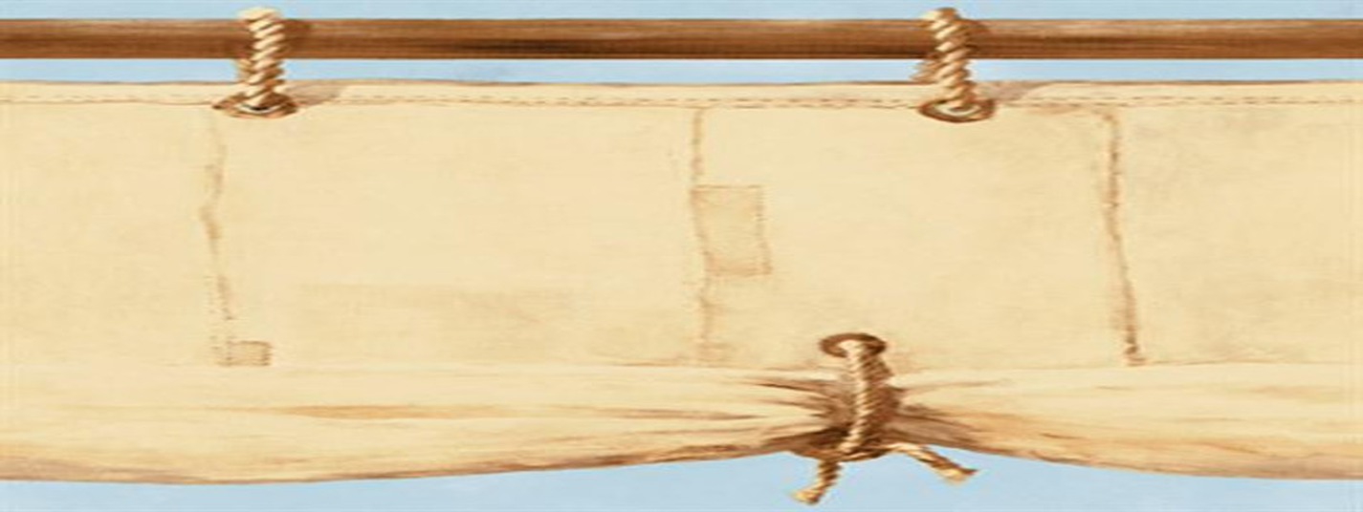
Revenue | Referral | Retention | Activation | Acquisition
 |  |  |  |  | Why
 |  |  |  |  | Who
 |  |  |  |  | How
 |  |  |  |  | What
The Pirate Canvas
Charting Your Service Ecosystem

Slide 186
Revenue | Referral | Retention | Activation | Acquisition | Taxis Suck
On-road costs | Centralization | Poor Service | Waiting | Undersupply | Why
 |  |  |  |  | Who
 |  |  |  |  | How
 |  |  |  |  | What

Slide 187
Revenue | Referral | Retention | Activation | Acquisition | Taxis Suck
On-road costs | Centralization | Poor Service | Waiting | Undersupply | Why
Industry Regulators | Dispatchers | Passengers | Drivers | Drivers | Who
 |  |  |  |  | How
 |  |  |  |  | What

Slide 188
Revenue | Referral | Retention | Activation | Acquisition | Taxis Suck
On-road costs | Centralization | Poor Service | Waiting | Undersupply | Why
Industry Regulators | Dispatchers | Passengers | Drivers | Drivers | Who
No special insurance | Automation | Sack offenders | Share location | More at peak | How
 |  |  |  |  | What

Slide 189
Revenue | Referral | Retention | Activation | Acquisition | Taxis Suck
On-road costs | Centralization | Poor Service | Waiting | Undersupply | Why
Industry Regulators | Dispatchers | Passengers | Drivers | Drivers | Who
No special insurance | Automation | Rate rides | Share location | More at peak | How
Lobbying Workflow | Locale Pub/Sub | 5-star feedback | GPS Sharing | Surge Pricing | What

Slide 190
Practice:
Now let’s run our own Pirate Canvas

Slide 191

Ecosystems thinking
Ecosystems are networks of mutual benefit
Whole board: think globally, act locally
Avoiding hill-climbing: iterative and reductive

Slide 192
Ecosystem
Ecosystems are networks of mutual benefit.

Slide 193
Ecosystem
The more different species they generate,
the more stable with changing constraints.

Slide 194
Ecosystem
The more different relationships they supply,
the more productive they become over time.

Slide 195
Ecosystem
And the less susceptible to catastrophe.

Slide 196
Ecosystem
The Chinese game of Go is a close analogy to business ecosystems.
Disconnected groups of stones starve and die as constraints evolve.
Successful Go ecosystems are only designed by “Whole Board Thinking”:
Find the space with the greatest development potential on the board.
Then narrow your focus. Breadth-first, iterative, contractive systems thinking.
Move after move, this is the only way to win. “Think globally, act locally”.
Notes:
What happened with “statement”?

Slide 197
Ecosystem
Deductive Reasoning
Abductive Reasoning
?
Unhappy
Paths
All swans are white.
I have a swan.
My swan is white.
Is it a white swan?
Is it a duck?
A chicken?
No but Warm …
Getting Colder …
Colder …
Customer
Inductive Reasoning
Reductive Reasoning
Grandpa swan is white.
Mama swan is white.
All swans are white.
Can it swim?
Size of a duck?
Is it white?
Yes ...
No ...
No …
Grandpa swan is white.
Papa swan is white.
What color is my swan?

Slide 198
Ecosystem
Mission & Metrics
Assessment
Allocation
Impact Mapping
Pirate Canvas
Product/
Portfolio
Squad
Throughput Accounting
Bottleneck Constraint
Simple Design
Awareness
Alignment
Ecosystem Architecture
Behavior Driven Analysis
Continuous Delivery
Chapter
Meetings
Continuous Learning
Acceptance Matrix
Business Bingo
Feature Budgets & Priorities
Architecture
Autonomy
Release Refactoring
Release Plan / Feature GTD
Leadership as a Service
Feature/
Systems
Squad
Kanbans & Backlogs
Autonomous Squads
© Peter Merel, 2016
Behavior Driven Development
Acceleration
Analytics
Generating an Agile Organization.
A feedback machine for the whole ecosystem
Notes:
What happened with “statement”?

Slide 199

Agile Organizations are composed of Agile Teams. So the original Agile values and principles still hold true. XSCALE doesn’t replace them. It inherits them.

Slide 200

Behavior Driven Analysis
Quick, Breadth-first Derivation of
Features & Acceptance Criteria

Slide 201
For each Pirate Canvas Epic
(a Why/Who/How/What):
Generate a starter set of Features
using CEASAR or CRUDITE pattern
Create/Edit/Abort/Save/Accept/Request-Help
Create/Read/Update/Delete/Import/Transform/Export
Pick Themes (key categories of acceptance criteria)
UX Personas
Architectural Components
Non Functional Qualities
Business Rules
For each Feature/Theme box, mark it if all agree:
Acceptance criteria exist for that Feature x Theme
Don’t record detailed criteria – just go breadth-first
Sanity-checking questions generate matrix closure:
For each Feature are there any missing Themes?
For each Theme, are there any missing Features?
If a Theme is all ticks, break out a Technical Feature

Slide 202

Business Bingo
Fast, Breadth-First Feature Budgets & Priorities

Slide 203
Lay out 10 Fibonacci Numbers to estimate Features per Epic
Add the last 2 Fibonacci numbers to make the next
We use Fibonacci because it makes people fight!
Use DRIs & LaaS to get Consensus
Pick 3 ”Budget Bears” – three pre-costed metric probes
Not relative; “Feature Points” are actual budget/Feature
Best Bears are previous Features everyone is familiar with
Baby Bear “was easy, no surprises” – say 3 team days
Poppa Bear big and hairy, ~20 times more expensive at 55
Mamma Bear is the mode – about same as most features
Tech authorities estimate, Business & Design question!
Compare feature cards one at a time vs. all on table
Split large Features by Theme; ideally all < 21.
Record estimates on cards and do over …
Pick 3 previous “Business Value Bears”
Baby Bear Feature just a bell or whistle
Mamma is in 80% we could live without
Poppa one of the 20% we use every day
Business estimates, Design/Tech question
Record Business Value number and then ROI:
ROI = 1 + ((Value² – Budget) / Budget)
+1 prevents negative ROI when B >> V
Squared Value prevents “ties” when V==B
Prioritize by descending ROI. Add COD if:
Technical dependency trumps ROI or,
Business forces trump ROI.

Slide 204

Release Refactoring
Quick, easy, reliable,
collaborative release planning.

Slide 205
Per Epic, lay out Features in descending ROI+COD priority
To hit a specific date, calculate FPs you have by then given your resourcing. Otherwise calculate release dates after.
Per Epic, top-down, ask Business “could we include any of this Epic in our next Release without this Feature?”
If not, this Feature is marked “Bronze”.
When you’re out of Bronze, ask, “Would leaving this next Feature out significantly reduce the Impact of next Release?”
If so, this Feature is marked “Silver”
Otherwise it’s marked “Gold”.
Now calculate how many total FPs and how much total ROI per each Bronze, Silver and Gold Group for each Epic.
To fit a Release Date, figure which mix of Bronze, Silver and Gold Groups > max ROI within the FP budget of the release.
Assume Silver requires Bronze, and Gold requires Silver.
Otherwise determine Release Dates by grouping for business drivers. IE. RAT, MVP, Next Bottleneck, Next Market, etc.

Slide 206
Optional:
Introduction to BDD in Gherkin.

Slide 207

How does Product Management drive Delivery?
Agile + BDD

Slide 208

The cost of quality is not linear …

Slide 209

Real numbers from CBA’s first BDD program
>50x in prod
47%
Kaching R28
>25x
All other R28
17%
>10x
>2x
Relative Cost of a Defect
X

Slide 210

It’s an old story …
Toyota, 1965: Automated acceptance tests halt the line.
“Poka-Yoke” eliminates rework in manufacturing.

Slide 211

BDD eliminates rework in Software Delivery …
More than that, it’s how we align on “Done”.
New Test / New Code
Continuous
Integration
Automated
Programmer
Tests
Automated
Acceptance
Tests
Human
Acceptance
Tests
Automated Deployment
BDD

Slide 212

BDD is something we do together.
Notes:
Mention slide is from NWOW. Talk about the GWT form and how it relates to various roles.

Slide 213

Acceptance criteria expand those ticks in the Features & Themes matrix.
As an <Actor>
In Order To <Behavior>
I want<System Behavior>
User Story
Value
Constraints
Acceptance
Criteria
Given <Conditions>
When <Events>
Then <Results>
Quality

Slide 214



Acceptance criteria elaborated by “Three Amigos”
Delivery Teams collaborate on these little requirements.
BAs
Devs
Elaborate
Acceptance
Criteria
Implement
Missing
Test Steps
Make
Step
Pass
Refactor
Testers

Slide 215




Virtualization enables BDD integration without collision.
Programmer Testing
Programmer Testing
BDD Test Authoring
CI
Build
Failure
Build
Success

Slide 216


CI is the modern “Poka-Yoke”. Zero Defect Tolerance.
Commit
Source Code
Control
System
Commit
Commit
Commit
Hook
System Integration Testing
Email
Feature Integration Testing
CI
Build
Failure
Build
Success
Source Code
Build &Test
Execute

Slide 217

BDD + Git enables parallel feature development
Each bubble is a changeset
with automated BDD tests
feature X
All automated tests run
Green before merge.
+ X
Deterministic history.

Slide 218

BDD enables Continuous Delivery.
Multiple Parallel
Feature Branches
Continuous
Integration
FIT & SIT
Environments
Hotfixes
Ready for
Deployment

Slide 219


Acceptance Criteria
Given, When, Then, And, But
Given: put the system in a known state before the user (or external system) starts interacting with the system (in the When steps)
Whens: describe the key action the user performs
Then: observe outcomes related to the business value/benefit in your feature description. The observations should inspect the output of the system (a report, user interface, message, command output)
And, But: If you have several Given, When or Then steps you can use And or But steps, allowing your Scenario to read more fluently:
Notes:
Mention minimum requirement i.e. given can be removed if background is correct. Min requirement is at least when and then.

Slide 220

Gherkin Syntax
Backgrounds
Backgrounds allows you to add some context to all scenarios in a single feature. A Background is like an untitled scenario, containing a number of steps.
The difference is when it is run: the background is run before each of your scenarios
It’s not
About UI.
Notes:
Reveal that what you have written (given when then) is actually a language called Gherkin
Explain other syntax.
Talk about backgrounds

Slide 221
Practical: Pick a Feature, generate the Gherkin

Slide 222

Gherkin Syntax - Tables
Tables
Tables as arguments to steps are handy for specifying a larger data set - usually as input to a Given or as expected output from a Then.
Notes:
Talk about tables

Slide 223


Gherkin Syntax - Outlines
Scenario Outline
Scenario Outlines allow us to more concisely express these examples through the use of a template with placeholders
The Scenario outline steps provide a template which is never directly run. A Scenario Outline is run once for each row in the Examples section beneath it (not counting the first row of column headers).
Notes:
After explaining, highlight the different between examples in the scenario outline, and the table in the previous slide

Slide 224


Gherkin Syntax - Tags
Tags
Tags are a great way to organize your features and scenarios and to be able to report on different sets of scenarios, e.g. business critical scenarios @businesscritical, @highvolume
A Scenario or Feature can have as many tags as you like, just separate them with spaces:
Notes:
Give some examples of tags.

Slide 225
Take existing scenarios and refactor with gherkin syntax.
Background
Step Table
Scenario outline
Example Table
Tags

Slide 226
Lean Coffee Q&A

Slide 227
Exponential Product Management
Why, Who, How & What?
The XSCALE Principles
Game: Exponential Minty Machine
Throughput Accounting
Practice: Pirate Canvas
Agile Contracts
Game: Prioritizing Market Impact
Forming a Product Squad
Practice: Behavior Driven Analysis
Using a Kanban to whip WIP
Practice: Behavior Driven Design
Continuous Delivery
Game: Set-based Logo Design
Ecosystem Design
Product Squad Ceremonies
LaaS & DRIs
Practice: Business Bingo
Change as a Product
Practice: Release Refactoring
Lean Tea

Slide 228
eXponential
TESTS
LEARN
BUILD
Product
REFACTOR
DATA
CODE
MEASURE
Management
Copyright © Peter Merel 2017 for Fast Pants Mobile Apps Pty. Ltd.
Notes:
What happened with “statement”?

